Slide 1
Are you Ready? RDA Basics for Copy Catalogers OLC Chapter Conferences, NE and NW March 27 and April 12, 2013
Sevim McCutcheon, Catalog Librarian; Assistant Professor
Kent State University, Kent, Ohio, USA
Lmccutch@kent.edu
330-672-1703
Notes:
Hello. I’m Sevim McCutcheon.
To give you a little background, for the past seven years, I’ve been a catalog librarian at Kent State University. There are 5 catalog librarians who catalog various formats here. I am responsible primarily for monographs and electronic theses and dissertations.
At Kent State University, we have been actively preparing ourselves and our staff for RDA since 2009. We accept copy cataloging in RDA, and have about 2,000 RDA records in our local catalog. In January 2013, we began original cataloging in most formats in RDA. At that time we also began creating Authority Records in RDA. We will switch to doing all original cataloging in RDA at the same time as the Library of Congress, March 31, 2013.

Slide 2
Agenda today
Part 1: FRBR and RDA
Little bit of theory
Changes between AACR2 and RDA in Descriptions
Exercises: Recognizing RDA features
Will not cover: Changes in Access Points
Part 2: Preparing a Technical Services Dept.
Technological side
People side
Notes:
Here’s what we’re going to cover today. I’ll introduce you to RDA and give you just a little theoretical background. The bulk of the time we’ll go through what’s different between AACR2 and RDA in typical bibliographic records. Once you get a good foundation, we’ll do some exercises together.
In part 2, we’ll talk about both the technological and the people side of making the transition to RDA: making sure that your catalog handles RDA records well, and that you and your coworkers can, too.
You should have two handouts. One gives instructions on accessing the RDA Toolkit for 30 days after this workshop. The other gives my contact information and a few links. The first link is KSU’s RDA page. I will post this PowerPoint presentation on KSU’s RDA page, so you will have easy access to all the resources and links to websites contained in the presentation. In other words, you won’t have to scramble to write them all down.
So, has everybody heard of RDA?
Has anybody seen an RDA record yet? Not sure?
Let’s start with what RDA is: Resource Description and Access is a set of rules that covers the descriptive cataloging of a record. It also instructs original catalogers in how to set up authorized access points, like for authors, conference names, and series. It’s the descriptive portion we’ll concentrate on today, because it’s most pertinent to your copy cataloging responsibilities. I’ll include a link to another person’s presentation about changes to access points that you can read later if you are interested, but I won’t discuss access points now, in the interest of time.
At first, when an international committee met to revise Anglo-American Cataloguing Rules, second edition, AACR2, they called their revision AACR3. But they changed the name for two reasons: they wanted to emphasize that the new instructions were for everybody, not just Anglos and Americans. And although RDA is based on AACR2 in some ways, it’s pretty different in others – different enough to require and justify a new name.

Slide 3
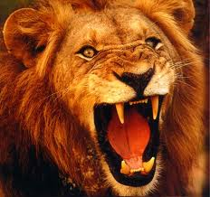
Your feelings about RDA? (google images)
Notes:
Any major change can be scary. And the transition from AACR2 to RDA is the first major change in cataloging rules in forty years. At the beginning, when you are first learning about RDA, it might seem like RDA is frightening and wild

Slide 4
Your feelings about RDA? (google images)
Notes:
But I promise that by the end of this workshop, RDA is going to seem tame and manageable. Maybe even cuddly.
Although this is meant to be a practical workshop, it would be good to start with a little theory. I’m going to throw a few acronyms at you, just so that if you hear them again, they’ll be familiar to you.

Slide 5
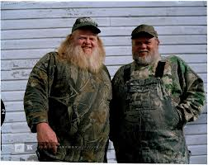
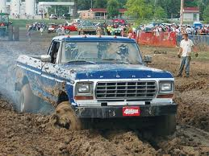
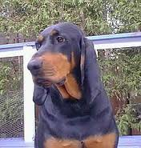
What is FRBR? (google images)
Notes:
I married a country boy who describes himself as a redneck – in the best sense of the word. (He actually looks a lot like the man on the left)
He knew one meaning of FRBR: By Rednecks, For Rednecks.
Now, thanks to meeting a catalog librarian, he knows the second meaning of FRBR. It also stands for Functional Requirements For Bibliographic Records

Slide 6
What is FRBR? (pronounced “furbur”)
Functional Requirements for Bibliographic Records
A conceptual model (model of the bibliographic universe) that underlies RDA
FRBR user tasks: Find/Identify/Select/Obtain
FRBR user tasks also called “FISO”
Notes:
FRBR is a conceptual model that forms the basis of RDA.
The organization of RDA and the RDA Toolkit is based on the organization of FRBR

Slide 7
WEMI = Works, Expressions, Manifestations, Items
Work = ideas in a person’s head, the original story, as in Romeo and Juliet
Expression = a specific text and language, as in a Turkish translation of Romeo and Juliet
Manifestation = a particular publication. Penguin Book’s 2011 publication of Romeo + Juliet
Item = one copy of a manifestation, a physical book (or DVD, or CD…)
Notes:
SPEAKING:
FRBR categorizes the bibliographic universe into Works, Expressions, Manifestations, and Items. Works and Expressions are both abstract ideas. Typically, it’s manifestations that we catalog nowadays. Our bibliographic records describe manifestations. Copies of books that all have the same ISBN are likely to be the same manifestation. When we have many physical copies of a manifestation, we call them items.
FOR PARTICIPANTS TO READ LATER:
A Work is a distinct intellectual or artistic creation. Doesn't have a language. It is an abstract idea, like in the author’s head, so it doesn’t have a physical form.
Same work is unchanged text with illustration added, translations, abridgements, enlargements, or arrangements of musical works.
A new work is created when there is substantial change to the abstract idea, such as in an adaptation for children, a parody, musical variations on a theme, abstracts, summaries. New work is a film based on a book.
Expression is the intellectual or artistic realization of a work , a version of a work. An expression can be a translation, a particular edition, or an abridged version. “Expression” is also an abstract idea.
Two expressions are the same work when there’s only a minor difference between them, and the idea behind them isn’t changed much.
Different expressions include a: poem that’s written, versus a poem that's performed out loud and recorded on a CD. Translations by various translators.
An Expression can differ by title, form, date, language, version or edition.
Manifestation is the physical embodiment of an expression of a work. A particular publication.
It represents all the physical objects that have the same characteristics, both in intellectual content and physical form.
Form of carrier is important: like DVD, print, microfiche. If the form of carrier is different between identical versions of an expression, then it's a different manifestation.
Nowadays, we catalog manifestations. For example, copies of books that all have the same ISBN are likely to be the same manifestation. ISBN is a manifestation identifier for books
An item is a copy. When we own many copies of a manifestation in a library catalog, we have several physical objects. Each one is represented by an item record which is attached to a bibliographic record
So an item is an individual, physical copy
Item identifiers can be barcodes.
The most important things to remember from this slide are these: that WEMI stands for Works, Expressions, Manifestations, and Items; and that typically it’s Manifestations that we catalog.

Slide 8
WEMI = Works, Expressions, Manifestations, Items (Picture from Tillett’s “What is FRBR?”)
Notes:
This is a saying that you might hear often when you read about FRBR:
A work is realized through an expression. An expression is embodied in a manifestation. A manifestation is exemplified by an item.

Slide 9
RDA Toolkit Table of Contents: http://access.rdatoolkit.org/
Section 1: Recording Attributes of Manifestation & Item
Section 2: Recording Attributes of Work & Expression
Section 3: Recording Attributes of Person, Family, & Corporate Body
Section 4: Recording Attributes of Concept, Object, Event & Place
Notes:
[Note to self: If I have Internet access, show the actual Toolkit table of contents.]: http://access.rdatoolkit.org/
The first section of the RDA Toolkit is devoted to Manifestations and Items. If you read any of the Toolkit, I suggest starting with Section 1, especially chapters 1 and 2, since they are about manifestations.

Slide 10
OLC NE : You have access to RDA Toolkit for 30 days, until April 27, 2013:
See handout for instructions
Notes:
Best of all, you can read RDA for yourself for the next month.
The managers of RDA Toolkit provide free 30 day access upon request for any workshop about RDA.
That means that if anyone here is inspired to provide an RDA workshop in the future, just contact RDA Toolkit and ask for 30 day free access for your participants.

Slide 11
OLC NW : You have access to RDA Toolkit for 30 days, until May 12, 2013:
See handout for instructions
Notes:
Best of all, you can read RDA for yourself for the next month.
The managers of RDA Toolkit provide free 30 day access upon request for any workshop on RDA.
That means that if anyone here is inspired to provide an RDA workshop in the future, just contact RDA Toolkit and ask for 30 day free access for your participants.

Slide 12
Recommended resources about FRBR
What is FRBR? / Barbara Tillett
http://www.loc.gov/cds/downloads/FRBR.PDF
FRBR: a guide for the perplexed / Robert L. Maxwell. Chicago: American Library Association, c2008.
Notes:
If you would like more information about FRBR, I highly recommend these two titles. One is freely available on the web and is written for laypeople. The other is a book available from the American Library Association.

Slide 13
What is RDA?
Resource Description and Access: a new cataloging standard
Intended to be successor to Anglo American Cataloguing Rules; is based on AACR2
Some international and U.S. libraries have adopted already; many more will adopt by March 31, 2013, when LC does
Notes:
So, what is RDA? It is a set of rules to guide the description of resources, and also the formation of access points. It is based on AACR2, so if you’re already familiar with AACR2 records and how they look, the time it takes to learn RDA might be shorter than if you are new to both
In the OCLC WorldCat database, there are many thousands of RDA records already.
We’ll be seeing a mix of different types of records for many years into the future.

Slide 14
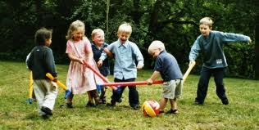
RDA records play well with AACR2 records OCLC’s new policy: http://www.oclc.org/us/en/rda/new-policy.htm
Notes:
One thing to remember is that RDA records are compatible with AACR2 records. It is not necessary to go back and convert your AACR2 records to RDA.
Even so, in OCLC’s WorldCat database, it is permitted, even encouraged, to add RDA elements to AACR2 records. In fact, OCLC plans to add RDA features to AACR records within the next few years, to make them consistent. This consistency may help in a transition away from MARC and into a new Bibliographic Framework.

Slide 15
Recommended resources about RDA
Introducing RDA: a guide to the basics / Chris Oliver. Chicago: American Library Association, 2010.
OCLC’s About RDA page:
http://www.oclc.org/us/en/rda/about.htm
Notes:
Here are some resources I recommend to learn more about RDA.

Slide 16
Recommended resources about RDA
Library of Congress resources, especially within the Catalogers Learning Workshop
http://www.loc.gov/catworkshop/RDA%20training%20materials/index.html
Includes a guide to Using the RDA Toolkit
Notes:
There is a very good guide to using the RDA Toolkit included among the resources at the Library of Congress website.

Slide 17
Recommended resources about RDA
KSU’s RDA website:
http://extra.lms.kent.edu/page/15168
Will have this presentation on it soon
MARC 21 Format for Bibliographic Data
http://www.loc.gov/marc/bibliographic/
Notes:
This presentation with all its links and recommended resources will be posted to KSU’s RDA website shorty.
KSU’s website was created for internal use, on an Intranet. So it’s a little rough. But I share it here to give you an example of what a library can do to collect and create training tools for RDA. It contains PowerPoints of in-house presentations my colleagues and I gave to our staff in Technical Services, among other things.
And the 2nd website provides a list of all possible MARC fields, their indicators, and examples of how to use them.

Slide 18
Recommended resources about RDA
NCSU’s RDA website
https://staff.lib.ncsu.edu/confluence/display/MNC/RDA+Test#RDATest-NCSURDATrainingDocumentation
Adam Schiff’s website: RDA presentations: look for newest “Changes from AACR2 to RDA,” both “Description” and “Access”
http://faculty.washington.edu/aschiff/
Notes:
North Carolina State University’s website, on the other hand, was created to share with the world.
Adam Schiff has done presentations in which he compares AACR2 and RDA. I have benefited greatly from his presentations for both Description and Access Points (what used to be called Headings in AACR2), and got ideas for this workshop from his presentations.

Slide 19
Changes from AACR2
JSC (Joint Steering Committee) website
http://www.rda-jsc.org/docs/5sec7rev.pdf
RDA in MARC (changes from AACR2)
http://www.loc.gov/marc/RDAinMARC29.html
OCLC Technical Bulletins 258, 260, 261
http://www.oclc.org/support/documentation/technicalbulletins/
Notes:
Here are good sources of information about changes from AACR2.
Because our time in limited, I cannot show you all the ways AACR2 and RDA differ. I will concentrate on the most common situations that you will see in bibliographic records. We will start with overall, general differences and then look at differences in particular MARC fields.

Slide 20
New Vocabulary
AACR2
RDA
Chief source of information
Area
Main entry
Added entry
Uniform title
Heading
See references
Preferred source of information
Element
Preferred access point
Access point
Preferred title for a work
Authorized access point
Variant access point
Notes:
There are some new terms in RDA for familiar AACR concepts. Here are some of them. I will be using the new terms as much as possible during this presentation, especially Preferred Source of Information, and Access points.

Slide 21
Principles of RDA
Transcribe what you see
Accept what you get
Fewer abbreviations, more words
Misspellings are transcribed as written, then explained in a note or an alternate title (246 field)
(There is an exception for misspellings in a serial title)
Also, there is the concept of “Core” and “Core if”
Notes:
Two main principles of RDA are to write down what you see, and to accept what is provided. Thus we will see fewer abbreviations.
Note also that there is a concept within RDA Toolkit of Core and Core If. Some elements are required, or Core. Some are required in certain situations, or Core If.
Also, there are some options in RDA that we as a cataloging community will have to make decisions about – whether to accept as is what other catalogers have done in RDA, or to choose an alternative from the options allowed. Here at KSU, we plan to follow the Library of Congress and Program for Cooperative Cataloging Policy Statements, the LC-PCC PSs. Unless there’s a really good reason not to. And then we’ll document the exception to aid future catalogers. Whatever you do on a local, consortial, or national level, it’s good to document and advertise your decisions.

Slide 22
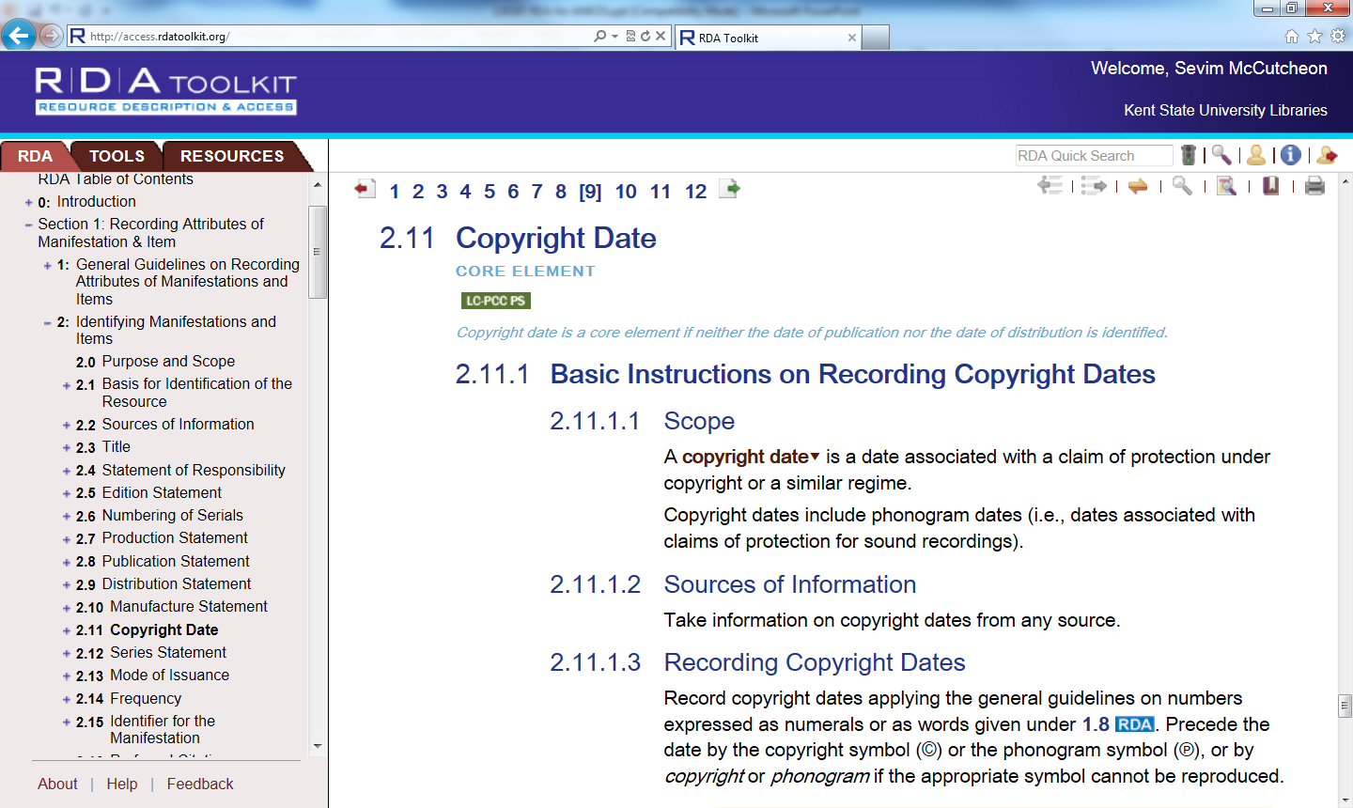
Notes:
Here is an example of a “Core if” statement, and also a Policy Statement within the RDA Toolkit. Note that under “Resources” you can access AACR2, too.
Now let’s get to what you’ve been waiting for: let’s look at some actual RDA records

Slide 23
How to identify RDA records
Notes:
This is a screenshot from the OCLC WorldCat database
Let’s start by identifying RDA records. How are they different from AACR2 records?.
Question: Can anyone tell me what the 040 field shows us?
Answer: Institutions that have participated in creating this record.
Also in this field are a few subfields for other things
Please notice here that this RDA record has in the 040 the subfield e, with the term “rda” in it

Slide 24
How to identify RDA records
Notes:
In addition to rda in that subfield,
In the fixed field portion of the record, in Description, there’s the code “I”. This is in place of seeing AACR2 records that say “A” for AACR2.

Slide 25
Capitalization – can Transcribe What You See
AACR2
RDA (1.7.1 Alternative)
245 10 Blackwell’s dictionary of Judaism : ‡b its mythology, folklore, philosophy, literature, and history / ‡c Margaret and James Stutley.
245 10 Blackwell’s Dictionary of JUDAISM : ‡b Its Mythology, Folklore, Philosophy, Literature, and History / ‡c Margaret and James Stutley.
Notes:
The default for capitalization in RDA is to use an in house style manual (like the Chicago manual of style), and the result can be capitalization just like it is now in AACR2 – like the example on the left. However, there’s an option in RDA to capitalize as you see it, and also to accept however a vendor renders the record. For example, if a vendor created a record from an automated process, and that process input the title in all capital letters, then it would save time for the cataloger to accept the record as-is, capital letters included.

Slide 26
Transcribe What You See
AACR2 1.1F7
RDA 2.4.1.4
245 10 Blackwell’s dictionary of Judaism : ‡b its mythology, folklore, philosophy, literature, and history / ‡c Margaret and James Stutley.
245 10 Blackwell’s Dictionary of JUDAISM : ‡b Its Mythology, Folklore, Philosophy, Literature, and History / ‡c Doctor Margaret and Reverend James Stutley, University of Honolulu.
Notes:
In RDA records, you might see some additional information in the statement of responsibility (245 $c) as well. If the title page says it’s written by Doctor Margaret and Reverend James Stutley from the University of Honolulu, then you may very well see those words in the statement of responsibility.

Slide 27
Brackets and Abbreviations
AACR2 1.0C1
RDA D.1.2.1 and 2.8.2.6, 2.8.4.7
260 $a [Cleveland, Ohio : $b Cleveland State University, $c 1998]
260 $a [S.l. :$b s.n.], $c 2011.
260 $a [Cleveland, Ohio] : $b [Cleveland State University], $c [1998]
260 $a [Place of publication not identified] : $b [publisher not identified], $c 2011.
Notes:
See how the the Latin abbreviations are gone, when you don’t know where or by whom something is published. Instead you write out “place of publication not identified”, and “publisher not identified.”
And for those times when the cataloger knows information but it doesn’t come from the preferred source of information, the elements each get their own set of brackets, instead of one long set.

Slide 28
Many, but not all, Abbreviations Eliminated
AACR
RDA
p.
ill.
col.
ca.
[s. l.]
[s.n.]
page(s)
illustrations
color [or sometimes colour]
approximately
[place of publication not identified]
[publisher not identified]
Notes:
As I mentioned earlier, many abbreviations are eliminated.

Slide 29
Not all abbreviations eliminated
AACR
RDA
min., sec., in.
cm.
min., sec., in. [no change]
cm.
Considered a symbol, not an abbreviation
Period at end of 300 if there’s a series
No period if no series
Notes:
However, standards of measurement are staying as abbreviations.
Including cm. for centimeters – it’s actually considered a symbol, rather than an abbreviation.

Slide 30
Misspellings
AACR2 1.0F
RDA 1.7.9, 2.3.1.4
245 14 The wrold [sic] according to Garp
OR
245 14 The wrold [i.e. world] according to Garp
245 14 The wrold according to Garp
AND
246 1_ $i Title should read: $a World according to Garp
Notes:
In AACR, there are a couple different ways to indicate that a misspelling is really on the source, using either a Latin abbreviation to show it’s truly the publisher’s error and not the cataloger’s error; or by putting” i.e.” and the correct word in brackets.
In RDA, you transcribe what you see, even if it contains a misspelling, and you provide the corrected version in another field. This is the way it is done for all formats, with the exception of misspellings in the title of serials.

Slide 31
Transcribing Marks of Punctuation Title on preferred source: If I became president …
AACR2 1.1B1
RDA 1.7.3
245 10 If I became president -- /$c Hillary Clinton.
245 10 If I became president… /$c Hillary Clinton.
Notes:
AACR2 had us change certain marks of punctuation when they were found on the preferred source of information.
However, RDA instructs us to transcribe punctuation as it appears on the source.

Slide 32
Supplied Other Title Information
AACR2 1.1E6
RDA 2.3.4
245 00 Cuyahoga Community College String Orchestra : $b [program].
245 00 Cuyahoga Community College String Orchestra.
500 Program.
Notes:
AACR2 says that we can supply a brief explanation to a title when the nature of the work is unclear, or when the title proper consists solely of the name of a corporate body or conference.
However, RDA does not specify that this is permitted, as it is contrary to the principles of recording what you see and accepting what you get. Instead, you can explain what the resource is in a note.
There are two exceptions. Supplying certain types of other title information IS okay for cartographic resources (that is, maps) under RDA rule 2.3.4.5 and moving image resources (that is, movies and DVDs) under RDA rule 2.3.4.6

Slide 33
Parallel Titles
AACR2 1.1D
RDA 2.3.3
245 00 English Turkish dictionary.
246 1_$i Parallel title on cover: $a İngilizce Türkçe sözlük
245 00 English Turkish dictionary = $b İngilizce Türkçe sözlük.
246 31 a İngilizce Türkçe sözlük
Notes:
AACR2 told us to transcribe parallel titles from the “chief source of information.”
In RDA, we can take a parallel title from anywhere in the resource. If that parallel title comes from a different source than the title proper, we have the option of stating that location in a note
Additionally, there is no limit in RDA as to how many parallel titles you can record.

Slide 34
Sources for Statement of Responsibility
AACR2 1.1A2
RDA 2.2.4, 2.4.2.2
Title page only, bracket if comes from elsewhere
T.p. verso: edited by John Smith
245 00 History of religion / $c [edited by John Smith]
Title page is first choice, but other places on resource okay. No brackets unless cataloger supplies
Title page verso: edited by John Smith
245 00 History of religion / $c edited by John Smith.
Notes:
RDA is more relaxed about where we get information. As long as it’s in the resource we have, it’s okay. If it comes from outside the resource, then we use brackets.

Slide 35
Rule of 3 is gone
AACR2 1.1F5: 4+ authors : list the first then …[et al.].
RDA 2.4.1.5 :
4+ authors: list all
245 00 ‡a Calculus : ‡b single variable / ‡c Deborah Hughes-Hallett … [et al.].
700 1_ Hughes-Hallett, Deborah.
100 1_ ‡a Hughes-Hallett, Deborah.
245 10 ‡a Calculus : ‡b single variable / ‡c Deborah Hughes-Hallett, Andrew M. Gleason, William G. MacCallum, and David O. Lomen.
700 for Gleason, Andrew M. and others is optional
Notes:
This is a big change: the rule limiting us to listing 3 or fewer authors is gone.
I’d like to point out three different things here.
1. RDA gets rid of Latin abbreviations. So when there are more than 3 authors, we no longer list one then use the Latin abbreviation, “et al.”
Instead, you can list all the authors that appear on your preferred source of information.
2. Also, the first author now goes in a 100 instead of a 700. That is, the first author gets a preferred access point instead of an added access point.
3. Last, it’s only required that the first named author gets credit. That is, the first author is in the 100 field, but none of the additional authors have to be placed in 700 fields – it’s optional.

Slide 36
Rule of 3 is gone
RDA 2.4.1.5 optional omission : 4+ authors + LC PCC PS
AACR2: 1.1F5: 4+ authors
245 00 Calculus : ‡b single variable / ‡c Deborah Hughes-Hallett … [et al.].
700 1_ Hughes-Hallett, Deborah.
100 1_ Hughes-Hallett, Deborah.
245 10 Calculus : ‡b single variable / ‡c Deborah Hughes-Hallett [and three others].
700 for others is optional
Notes:
Another option under RDA is to replace “et al.” with brackets then write in brackets [and however many others]. Note, however, that the Policy Statement says, “generally, do not omit names in a statement of responsibility.” The method shown on the previous slide is preferred.
Even if the other authors aren’t listed in the body of the record, it is okay to give them credit in 700s.
As you can see with the rule of three examples, in RDA we give up some consistency and in exchange we get some flexibility.

Slide 37
245 subtitles and noun phrases
AACR
RDA 2.4.1.8
245 10 ‡a Antiquities : ‡b seven stories / ‡c John Crowley.
245 10 ‡a Otherwise : ‡b three novels / ‡c by John Crowley.
245 10 ‡a Antiquities : ‡b seven stories / ‡c John Crowley.
no change--no grammatical connection
245 10 ‡a Otherwise / ‡c three novels by John Crowley.
RDA change--grammatical connection
Notes:
RDA 2.4.1.8 says that if a noun or noun phrase occurs with a statement of responsibility, treat the noun or noun phrase as part of the statement of responsibility. Also, in case of doubt, treat the noun or noun phrase as part of the statement of responsibility. You can see here that the word “by” makes a difference.

Slide 38
250 Edition – transcribe what you see
AACR2
1.2B1, B.5A, C.2B1, C.3B1
RDA 2.5.1.4, B.4, 1.8.1 and D.1.2.1
Abbreviate full words
Source: First edition
1st ed.
Source: 2nd ed.
250 2nd ed.
Transcribe what’s there
Source: First edition
250 First edition.
Source: 2nd ed.
250 2nd ed..
note ending punctuation
Notes:
When you see an edition statement, write down what you see. If it’s spelled out in words, then transcribe the words. If it is already abbreviated on your resource, then transcribe the abbreviation.
On the RDA side of the screen, note the 2nd period after “ed.” This is technically right, according to RDA and ISBD. Frankly, I expect a lot of errors with the extra period getting left out. Happily, if it is left out, it’s just a minor error - it doesn’t affect access. Personally, I am more concerned with major errors, those that make it difficult for users to find, identify, select, and obtain resources.

Slide 39
Field 264 replaces 260 and is repeatable
http://www.loc.gov/marc/bibliographic/bd264.html
264: Production, Publication, Distribution, Manufacture, and Copyright Statements
First indicator: sequence of statements
Blank = Not applicable/No information provided/Earliest
2 = Intervening
3 = Current/Latest
Notes:
In early RDA records, from 2010 to mid-2012, all kinds of publication-related information was recorded in the 260 field, because there wasn’t an alternative.
Now, however, all new and newly upgraded RDA records should use the 264 field instead. It provides more granularity, a better breakdown of information.
The first indicator is used to show changes in production, publication, distribution, and manufacture elements for multi-volume monographs, serials, and integrating resources.

Slide 40
Field 264 replaces 260 and is repeatable
http://www.loc.gov/marc/bibliographic/bd264.html
264: Production, Publication, Distribution, Manufacture, and Copyright Statements
Second indicator: function of entity
0 = Production
1 = Publication
2 = Distribution
3 = Manufacture
4 = Copyright Notice Date
Notes:
The second indicator tells us what kind of function the corporate body performed: production, publication, distribution, or manufacture. There is also an indicator specifically for copyright date. The ones we’re likely to see most often are 2nd indicator 1 for publication, and 2nd indicator 4 for copyright date.

Slide 41
“Old” RDA record: 260 used
Notes:
Here’s an example of an RDA record, showing several features we’ve talked about so far.
What do you notice that’s different from the AACR records we see?
Answers:
040 $e rda
Fixed Field Desc i
Fixed Field DtSt t , Dates 2010 and 2010
245 $c includes “district judge”
$c [2010] c21010. Note that for copyright information, the actual copyright symbol is used, instead of the letter “c” to represent copyright.

Slide 42
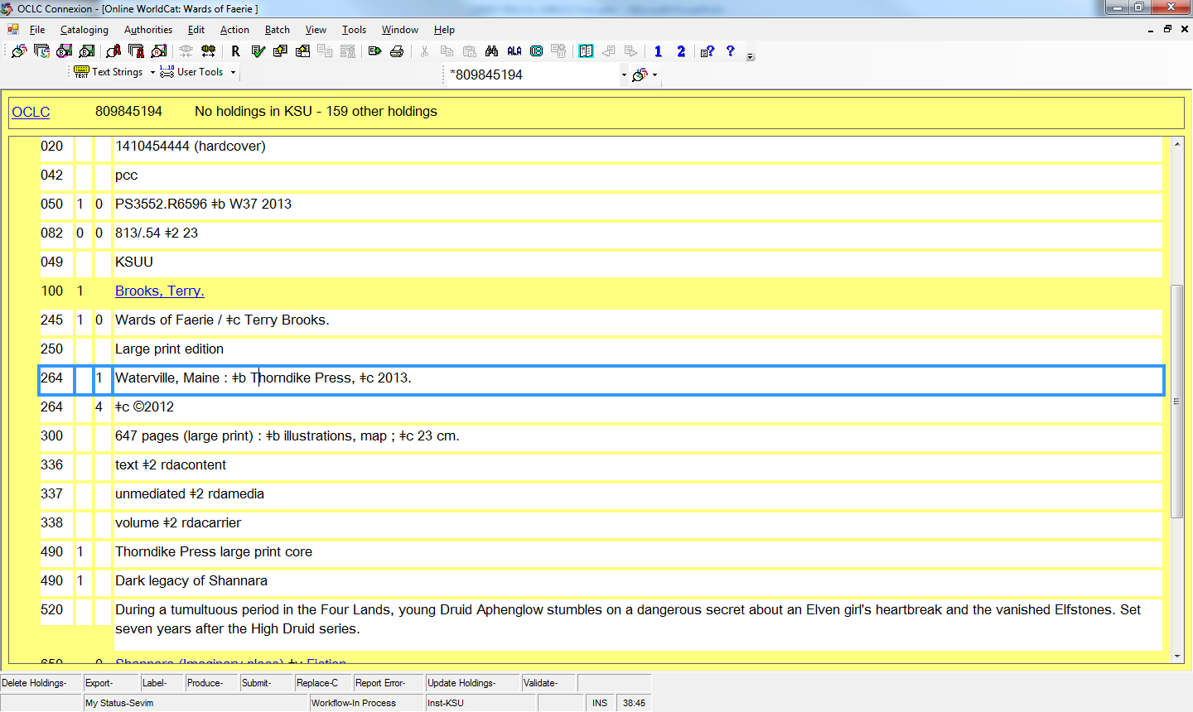
“New” RDA record: 264 used
Notes:
Here’s an example of an RDA record with the date of publication 2013 and the copyright date of 2012. This is how it looks in two separate 264 records.
What other differences do you see between this and an AACR2 record?
Answers:
Doesn’t appear on this slide, but record does have:
040 $e rda
Fixed Field Desc I
Fixed Field DtSt t , Dates 2013 and 2012
Can see on slide:
250 “Large print edition” is spelled out
Second 264: For copyright information, the actual copyright symbol is used, instead of the letter “c” to represent copyright.
300: no abbreviations; “pages” and “illustrations” are spelled out
336, 337, 338 fields – we will talk about them soon

Slide 43
260 -> 264; transcribe what you see, make notes when necessary
AACR 1.4B6,1.4C4
RDA 2.8.1.4, 2.20.7.3
Source: Inarticulate Publishing, Columbus, 2010
260 Columbus [Ohio] : $b Inarticulate Pub. , $c 2010.
Source: Inarticulate Publishing, Columbus, 2010
264_1 Columbus : $b Inarticulate Publishing , $c 2010.
500 Published in Ohio.
Option 2.8.2.3 Supply the larger place if needed for identification [in brackets]
Notes:
In AACR2, the cataloger had the option of putting the larger place in brackets, when it wasn’t on the piece.
In RDA, the rules say to make a note about the place of publication instead.
However, there is a recently-approved option to include the larger jurisdiction if needed for identification. Since the larger place is coming outside the preferred source of information, it should be in brackets.

Slide 44
Place of Publication, Distribution, etc.
AACR2 1.4C5
RDA 2.8.2.4
Ankara ; $a New York : $b Nihal Yayınevi, $c c2013.
Source says:
Ankara, Berlin, New York
Bibliographic record created by a United States library
264_1 Ankara ; $a Berlin $a New York : $b Nihal Yayınevi, $c [2013]
264_4 $c ©2013
OR
264_1 Ankara : $b Nihal Yayınevi, $c [2013]
264_4 $c ©2013
Notes:
AACR2 gave rather complicated instructions about what to do when there are multiple places of publication listed. Always, the cataloger gave the first place listed. Then the results changed based on the country of the cataloger. If the first place was in the country of the cataloger, the 260 $a was finished. If some additional place listed was in the same country as the cataloger, then the cataloger included that additional place also. But omitted all other places.
In RDA, we record either ALL the places of publication, distribution, etc.; or only the FIRST one.

Slide 45
Publication, Distribution, etc. Source: Department of Physics, Pittsburgh University, Pittsburgh, Pennsylvania
AACR2 1.4B4 + Appendix B
RDA 2.8.1.4
260_ _ Pittsburgh, Pa. : $b Dept. of Physics, Pittsburgh University
264_1 Pittsburgh, Pennsylvania : $b Department of Physics, Pittsburgh University
Notes:
AACR2 says to use abbreviations from Appendix B for certain pieces of information.
In RDA, we generally don’t abbreviate unless the abbreviation appears on the piece. Note here that “Pennsylvania” is spelled out, and so is “Department.”

Slide 46
Approximate Date of Publication, Distribution, etc. (from Adam Schiff’s website)
AACR2 1.4F7, 2.16G
RDA 1.9.2
[1971 or 1972]
[1969?]
[between 1906 and 1912]
[ca. 1960]
[197-]
[197-?]
[18--]
[18--?]
[not after Aug. 21, 1492]
[1971 or 1972]
[1969?]
[between 1906 and 1912]
[1960?]
[between 1970 and 1979]
[between 1970 and 1979?]
[between 1800 and 1899]
[between 1800 and 1899?]
[not after August 21, 1492]
Notes:
When we can estimate a date of publication, we should do so, in both AACR2 and RDA.
Note that AACR2 1.4.F7 tells us that “between” dates should be fewer than 20 years apart. In RDA, we can have “between” dates spanning any number of years.
And RDA 2.8.6.6. tells us that when the date of publication is not identified in a single-part resource, supply the date or approximate date of publication. Because we now have so many options for conveying estimated dates, it should be a last resort to use instead the phrase in brackets, [date of publication not identified].

Slide 47
300 physical description RDA 2.4.5.2 Single volume RDA 7.15 Illustrative content LC-PCC PS 1.7.1 punctuation
300 __ xvi, 31 pages : ‡b color illustrations ; ‡c 18 cm.
490 1_ Digitale Bibliothek
300 __ xvi, 31 pages : ‡b color illustrations ; ‡c 18 cm
No 490 series, so no period after cm
Notes:
The physical description in RDA is similar to what we are used to. However, abbreviations are spelled out. Note that some catalogers will use the British spelling of color, “colour”
Although I consider periods a minor matter, I’d like to inform you of something you might see and wonder about.
Here’s an example of a 300 field followed by a series, so the cm has a period after it. And an example of a 300 with no series, so there’s no period after the cm

Slide 48
336-338 – no more GMD
245 00 Bliss ‡h [videorecording].
GMD [not used in RDA; not possible]
MARC 336-338 fields “replace” GMD; each field is repeatable to account for media combinations
336 (content type)
337 (media type): not mandatory in the rules
338 (carrier type)
Notes:
Now I’ll explain a more important difference.
Does everyone know what a GMD is? General Material Designator. Indicates format.
A big change, especially for those of us who work with non-print or audiovisual material, is that in RDA there is no GMD. It’s replaced by 3 fields, the 336 for content, 337 for media, and 338 for carrier

Slide 49
336 Content Type RDA 6.9
336 Content: What is it? What sense is needed?
Examples:
text
performed music
notated music
spoken word
two-dimensional moving image
three-dimensional form
Notes:
Content has to do with what something is, what sense is needed to experience it
Text = book or serial
Performed music = a sound recording of music
Notated music = score
Spoken word = a sound recording of a book, etc.
Two-dimensional moving image = videorecording
Three-dimensional form = a globe, a toy, etc.

Slide 50
337 Media Type RDA 3.2
337 media: what equipment is needed to use?
Examples
audio
computer
microform
projected
unmediated
video
Notes:
Media type has to do with what equipment is needed to use the resource.
Examples:
Audio = used for sound recordings
Computer = used for electronic resources
Microform = used for things that require a microfiche or microfilm reader
Projected = used for motion pictures or slides, things that are projected
Unmediated = used for things that can be perceived directly without a machine, like print books and serials
Video = used for things that require a videocassette player or a DVD player

Slide 51
338 Carrier type RDA 3.3
338 carrier: what is it housed in?
Examples:
audiocassette, audio disc
computer disc, online resource
microfiche
film reel
card, flipchart, volume
videocassette, videodisc
Notes:
338: carrier type : What is it housed in?
And here are some examples
Examples:
audiocassette, audio disc
computer disc, online resource
microfiche
film reel
card, flipchart, volume
videocassette, videodisc

Slide 52
336-338 for a DVD
AACR
RDA
245 00 Bliss ‡h [videorecording].
300 __ ‡a1 videodisc (85 min.) : ‡b sd., col. ;
‡c 4 3/4 in.
245 00 Bliss.
300 __ 1 DVD (85 min.) : ‡b sound, color ; ‡c 4 3/4 in
336 __ ‡a two-dimensional moving-image ‡2 rdacontent
337 __ ‡a video ‡2 rdamedia
338 __ ‡a videodisc ‡2 rdacarrier
Notes:
Here’s what a GMD looks like in AACR, and what the content, media, and carrier fields look like a DVD record made under RDA
One of the decisions for us to make as a cataloging community is how much and what portions of the 336-338 to show to the public. What would be helpful to them? We could choose to display some of the elements and not others. Part of the answer lies in how our system will handle these fields: can they be used to generate user-friendly icons, for example.

Slide 53
336-338 for a book
AACR
RDA
100 1_ Wells, H. G. $q (Herbert George), $d 1866-1946.
245 14 The war of the worlds / $c by H.G. Wells.
300 __ 268 p. : $b ill. ; $c 22 cm.
100 1_ Wells, H. G. $q (Herbert George), $d 1866-1946.
245 14 The War of the Worlds / $c by H.G. Wells.
300 __ 268 pages : $b illustrations ; $c 22 cm
336 __ text $2 rdacontent
337 __ unmediated $2 rdamedia
338 __ volume $2 rdacarrier
Notes:
Here’s the standard content, media, and carrier types for a book: text, unmediated, volume.

Slide 54
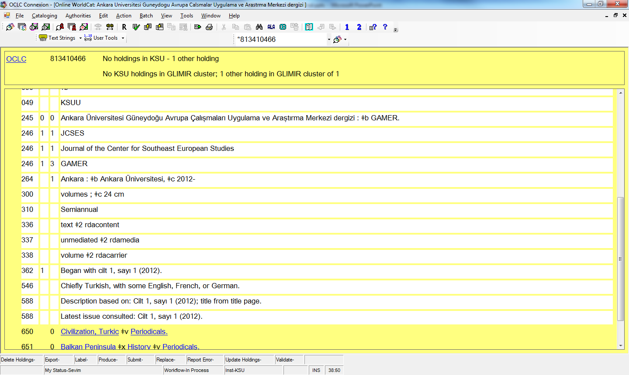
Notes:
Serial example:
Note that the 336, 337, 338 are: text, unmediated, volume

Slide 55
Notes:
Sound recording example: 336 is performed music, the 337 is audio, and the 338 is audio disc

Slide 56
Notes:
Here’s a short exercise.
What do you see that’s distinctive in RDA records? How is this record different from an AACR2 record?
100 $e author
245: placement of $c, lack of $b for “a novel”
250 First edition is spelled out
260
A. (this is tricky) CO for Colorado is the postal code instead of the AACR2 abbreviation – CO must have appeared this way on the book, and so it was transcribed.
B. (this is tricky) AACR says to shorten the form of the publishers name to the shortest form that’s still internationally recognizable, so in AACR2, we could use just “David C. Cook” without the word “Publishers” but in RDA, we’re to transcribe what we see without putting in extra things or taking things out, so “Publisher” remains
C. Publication date followed by copyright date with the copyright symbol (Note that this is the “old” way of inputting publisher information; the new way is to use a 264 field)
300 “pages” spelled out, no period at end of cm because there’s no series
336, 337, and 338 fields.

Slide 57
New fields http://www.loc.gov/marc/RDAinMARC29.html and http://www.loc.gov/marc/bibliographic/
344 – Sound Characteristics 345 – Projection Characteristics of Motion Picture Film 346 – Video Characteristics 347 – Digital File Characteristics
Ebook example
300 1 online resource (300 pages) : $b illustrations (some colour)
347 text file $b PDF $2 rda
Notes:
There are more new fields in RDA, mostly for audiovisual or non-print material.
This is just a taste of the new fields.
The main thing for copy catalogers to remember is that some information in a bibliographic record might show up in a field that’s new to you. Original catalogers may want to read more at the websites listed on this slide

Slide 58
Series numbering
AACR2 1.6G, Appendices B,C
RDA 2.12.9, PS 1.8.2, 1.83
Source: Volume fifty-four
1 Liquid crystals series ; $v v. 54
Source: Number IX
490 1 Humanities series ; $v no. 9
830 0 Humanities series ;$v no. 9
Source: Volume fifty-four
1 Liquid crystals series ; $v volume 54
Source: Number IX
490 1 Humanities series ; $v number IX
830 0 Humanities series ;$v no. 9
Notes:
AACR2 tells us to abbreviate words and numerals as in appendices B and C for series
RDA tells us to transcribe the words we see. And the LC-PCC-PS at 1.8.2 tells us that this means roman numerals, also. However, when a number is spelled out in words, we record the number.
So, in the 490, a transcription field, we transcribe pretty much what we see.
Remember that when it comes to series, the 490 is only half the story. Each 490 gives us what was seen on the piece. Then it’s paired with an 8xx field, typically an 830. That 830 shows us the authorized form of the series. In the 830, we’ll continue to use the instructions as given in series authority records for numbering

Slide 59
Serials Titles Source: 2013 Annual Report
AACR2 12.1B7
RDA 2.3.1.4
245 10 Annual report / ANKOS.
Rather than … Annual report
245 10 … Annual report / ANKOS.
Notes:
When you have a year at the beginning of a serial title, you still omit it. The difference is, in RDA, you use marks of omission.

Slide 60
Misspellings in Serial Title
RDA 2.3.1.4 Transcribe title as it appears on the source of information. Exception: for serials and integrating resources, correct obvious typographical errors, and make a note.
245 00 Housing starts
Source of information on v. 1, no. 1 reads: Housing sarts
Notes:
I mentioned this earlier, and here I want to point you to the rule and the exception about misspellings in serial titles

Slide 61
Supplying other title information: do not, except for…
For cartographic resources: RDA 2.3.4.5, to show area covered or the subject
245 00 Vegetation : $b [in Botswana]
For moving image resources: RDA 2.3.4.6
245 00 Gone with the wind : $b [trailer]
Notes:
We are allowed to supply other title information, but only for cartographic resources (maps) and moving image resources (videorecordings and movies)

Slide 62
Moving image resources 2.4.11 and 7.4
Non-cast contributors. Should people like directors, writers, producers be placed in a note, rather than in the 245 $c, statement of responsibility?
Waiting on “best practices” from OLAC (Online Audiovisual Catalogers)
For now, Sevim recommends continuing AACR2 practice of recording in 245 $c
Notes:
There is some ambiguity in the meaning of RDA rules about how to give credit to non-cast contributors. These are people like directors, writers, and producers who have some overall responsibility for the creation of the movie. There are two possibilities: that there is a change from AACR2, and these people now go in a 508 note; or there is no change from AACR2, and we continue to record them in the statement of responsibility, the 245 subfield c. The topic has generated a good deal of discussion on cataloger’s discussion lists like OLAC, AUTOCAT, and RDA-L. Because the Library of Congress catalogs few moving image resources, we’re unlikely to get guidance from LC. However, there is a strong organization for non-print catalogers, called OLAC. It is likely to come out with recommended best practices soon. If you catalog audiovisual materials, I recommend that you look at the OLAC website.

Slide 63
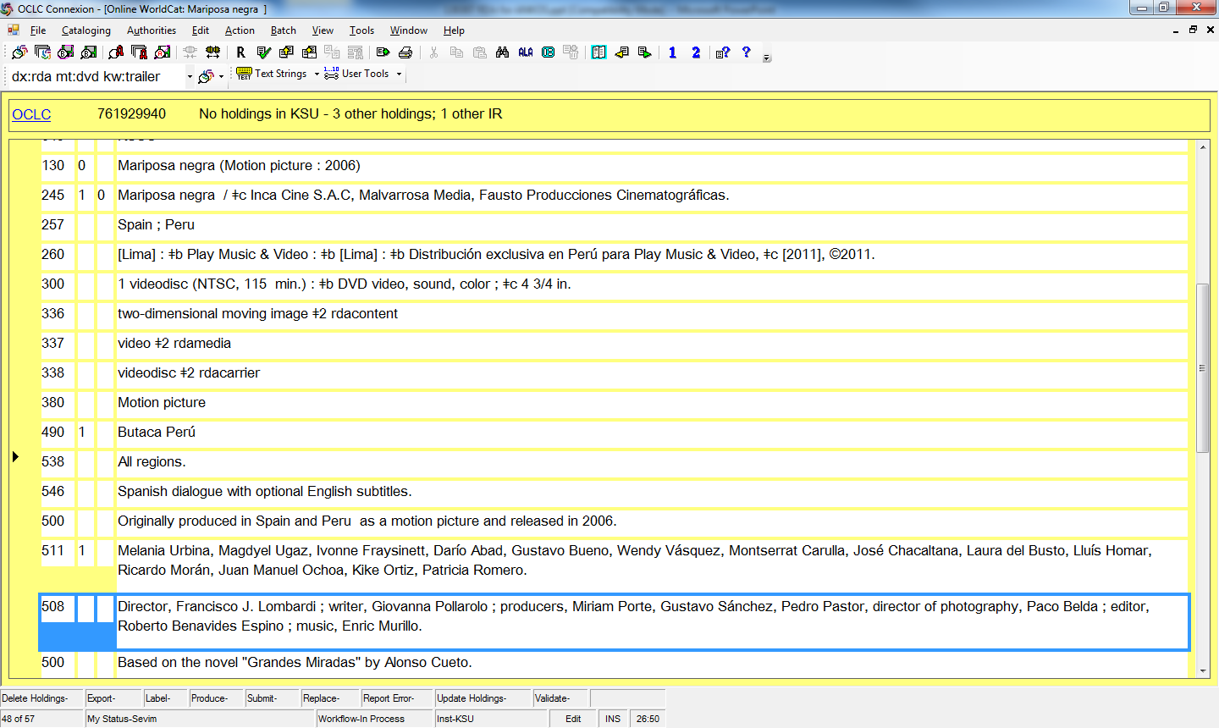
Notes:
In this case, the cataloger interpreted RDA rules to mean that all non-cast creators go in a note, rather than in the 245 $c. Remember, this aspect of RDA is in flux, so the issue isn’t decided yet. Neither way is wrong.
See also that this is based on a book. Under AACR2, we would have created a note like this one, then added a 7xx field for the author and title of the book which the movie was based on. In RDA, we emphasize the relationships and specify relationships. See how it’s done in the next slide:

Slide 64
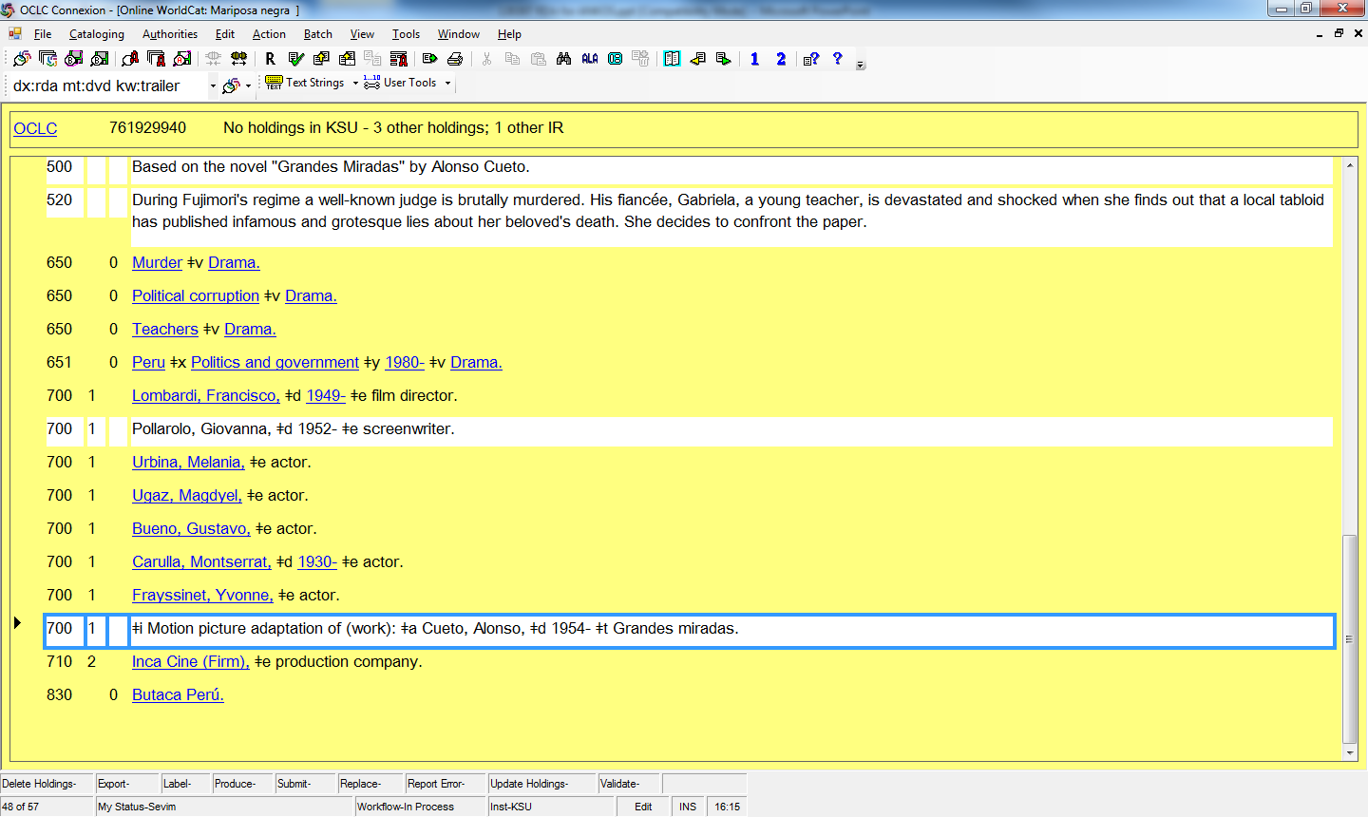
Notes:
One of the strengths of RDA is how much emphasis there is on conveying relationships. If you look at the top of this screen, you’ll see that this is a movie based on a book. Just like in AACR2, we still have a 500 note saying that, plus a 700 for creator and title of the book the movie’s based on. The difference is that in RDA, we include more information, a subfield i explaining the relationship, and telling us whether the relationship is to a work or expression.
Look also at the other 7xx fields. Each one has a relationship designator in subfield e.
Basic instructions on recording relationship designators are found in RDA 24.5.1

Slide 65
Resource lacking a collective title
RDA 2.3.2.9: when preparing a comprehensive description for a resource that lacks a collective title, record the titles proper of parts as they appear on the source of information for the resource as a whole.
Most frequently, this is relevant for sound recordings of music, but can apply to other formats as well
Notes:
This situation doesn’t come up very often, but our Music and Media Cataloger would kill me if I didn’t at least mention it.
Sometimes, you get a book with a bunch of stories that in lieu of a title drawing them all together, the book just lists the stories and authors one after another. This is a resource with no collective title. Most frequently, we see this with sound recordings, but it can occur in other formats, too.
RDA 2.3.2.9: when preparing a comprehensive description for a resource that lacks a collective title, record the titles proper of parts as they appear on the source of information for the resource as a whole.
So what does this look like?

Slide 66
Compilations lacking a collective title (from Adam Schiff’s website)
AACR2 21.7.C1
RDA 6.37.1.4, 17.8, 24.5.1.3
100 1 Baden, Conrad.
240 10 Symphonies, $n no. 6
245 10 Sinfonia espressiva $h [sound recording] /$c Conrad Baden. Symphony no. 3, op. 26 / Hallvard Johnsen. Symphony no. 2 / Bjarne Bustad.
700 12 Johnsen, Hallvard. $t Symphonies, $no. 3, op. 26.
700 12 Brustad, Bjarne. $t Symphonies, $n no. 2.
245 00 Sinfonia espressiva /$c Conrad Baden. Symphony no. 3, op. 26 / Hallvard Johnsen. Symphony no. 2 / Bjarne Bustad.
700 12 Baden, Conrad. $t Symphonies, $n no. 6.
700 12 Johnsen, Hallvard. $t Symphonies, $no. 3, op. 26.
700 12 Brustad, Bjarne. $t Symphonies, $n no. 2.
Notes:
The slide here is awfully dense, but it gives you some idea of how it’s done differently from AACR2 to RDA.
There is an option for the cataloger to devise a collective title, but it is discouraged by the LC-PCC-PS

Slide 67
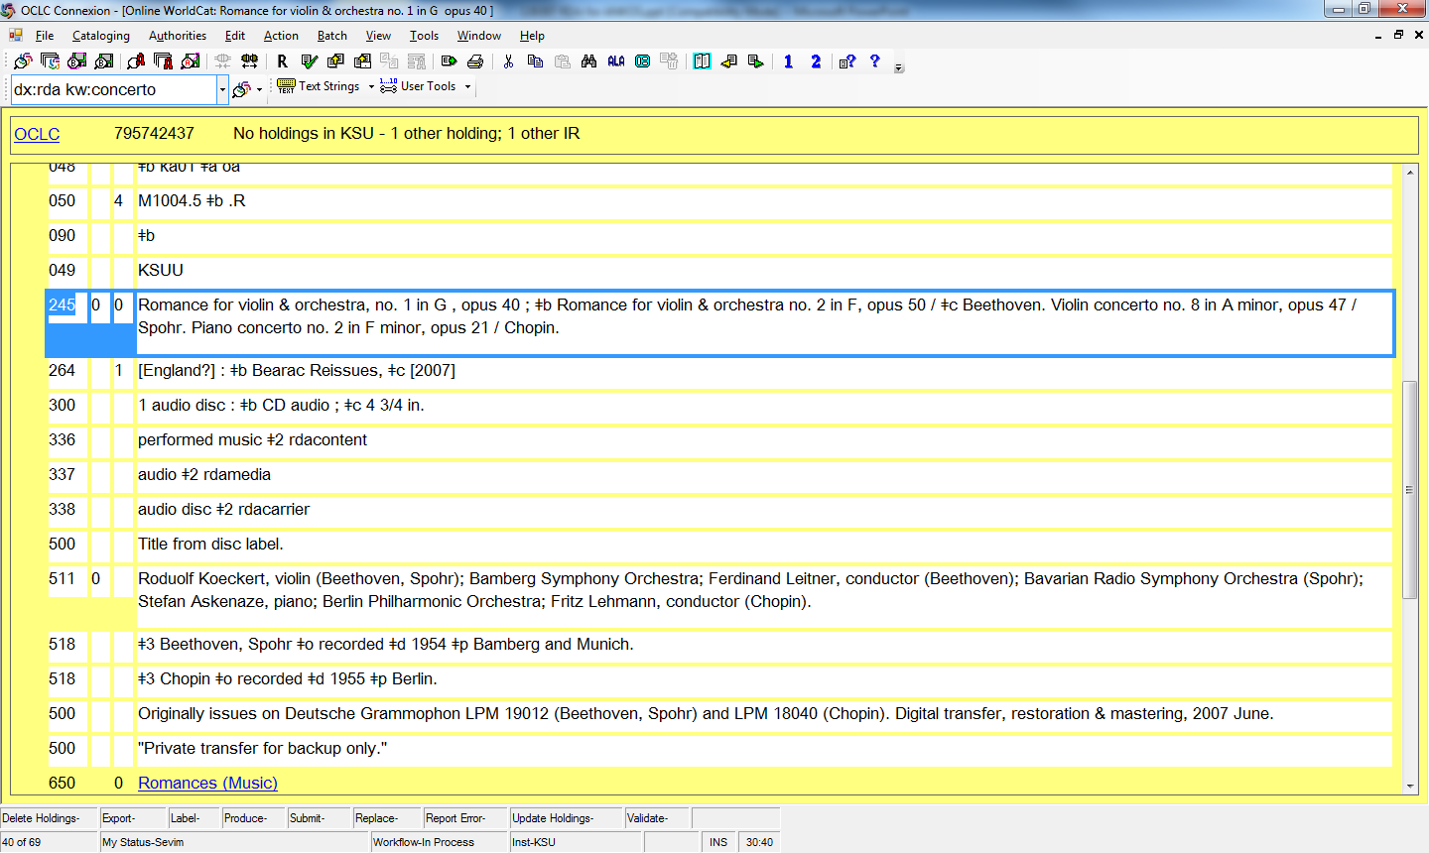
Notes:
See here that there are four musical works. All four are listed because there is no collective title. In addition, the first composer is not given a preferred access point.

Slide 68
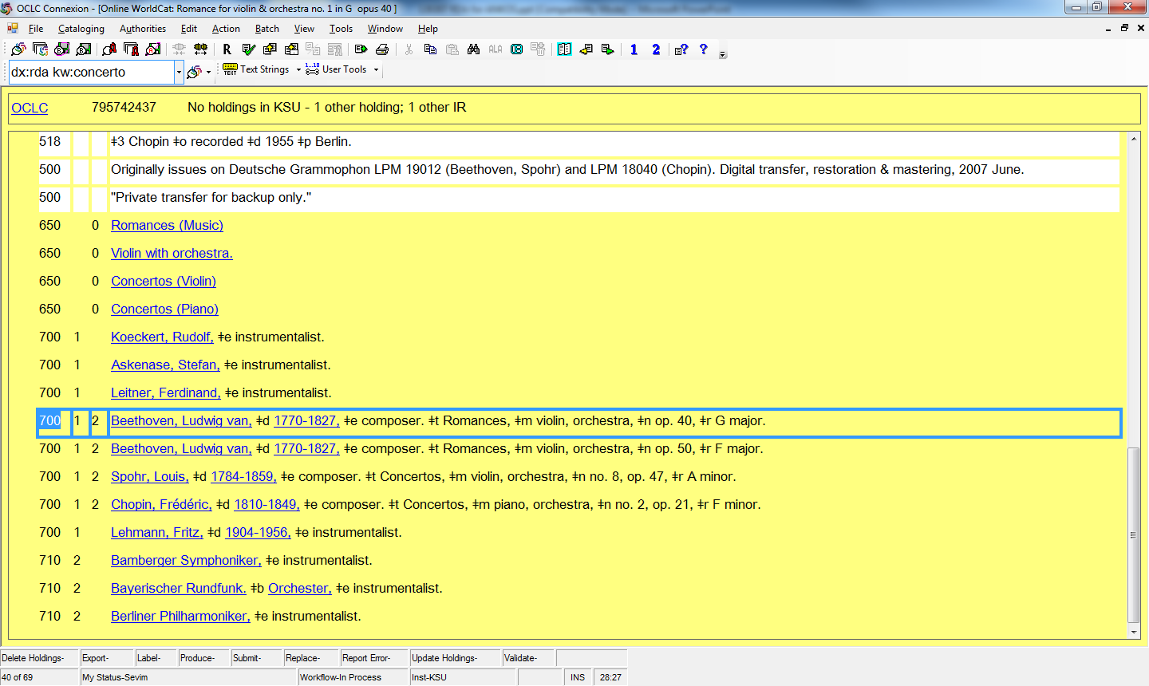
Notes:
And here’s the bottom part of that same record, including many relationship designators.

Slide 69
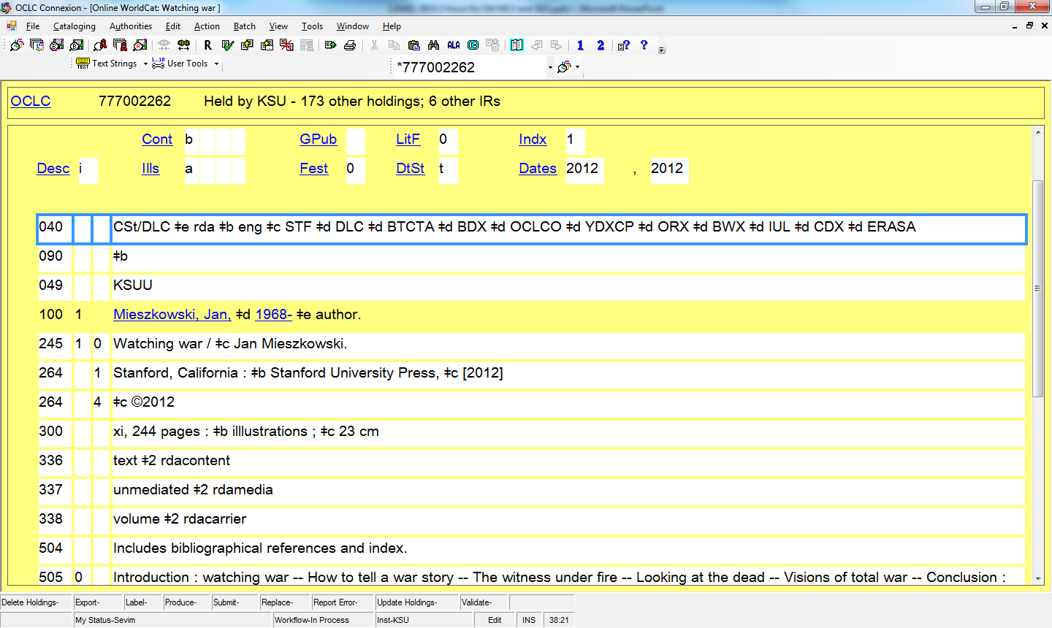
Notes:
Here’s a print book
What differences can you see between this RDA record and an AACR2 record?
All exercises:
Exercises just to recognize changes between AACR2 and RDA
Watching war, OCLC no. 777002262
Liquid crystals beyond displays, OCLC no. 775591919
Implementing responsive design, OCLC no. 809169765

Slide 70
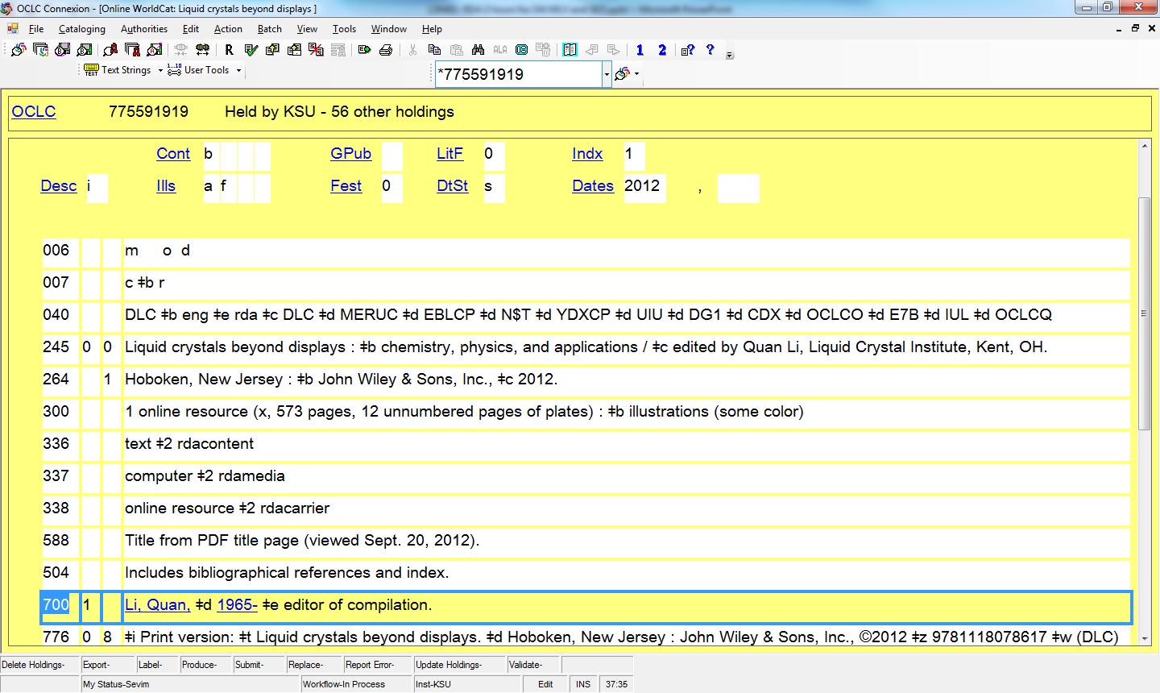
Notes:
Here’s an ebook

Slide 71
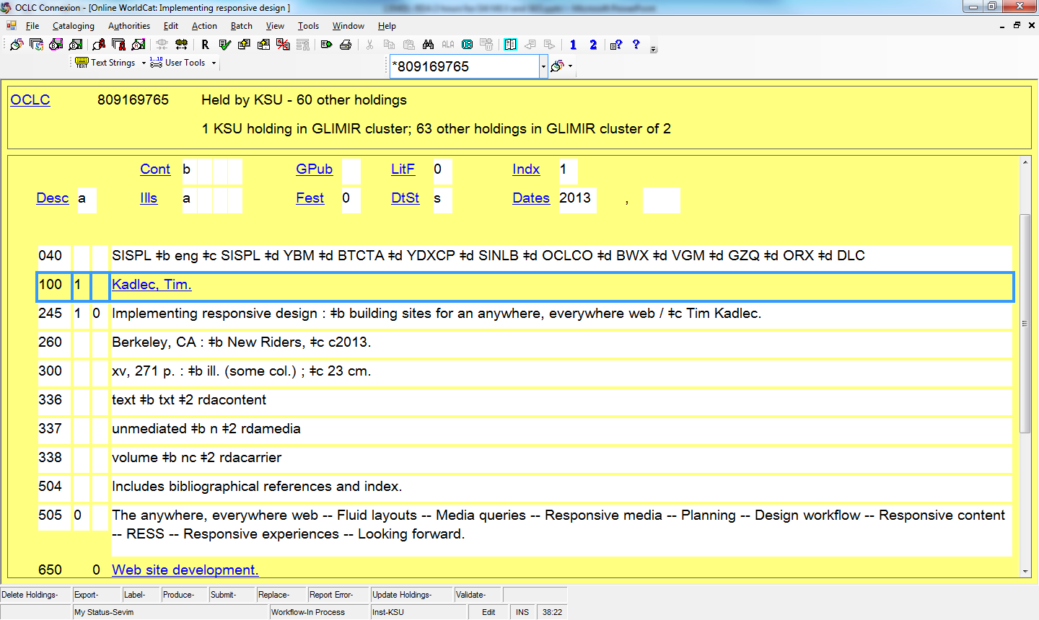
Notes:
Just two questions here:
Is this an RDA record?
Why or why not?

Slide 72
For more information…
Website of Adam Schiff, University of Washington
http://faculty.washington.edu/aschiff/
Then “RDA Presentations”
“Changes from AACR2 to RDA: A Comparison of Examples, Part I: Description”
For information about RDA in Access Points in records (the portions under authority control, like authors, conference names, series, subject headings) see “Changes from AACR2 to RDA: A Comparison of Examples, Part 2: Access Points”
Notes:
I highly recommend Adam Schiff’s website, as a source for more detailed information about the changes between AARC2 and RDA. He has presentations about Description, that go into more depth than I have here. He also has presentations about Access Points, which we’re not covering today.

Slide 73
Fictional entities can be considered creators
AACR2 21.4C1
RDA 9.0, 19.2, 18.5
100 1 Daniels, Cynthia.
245 10 It’s not easy being green /$c by Kermit the Frog as told to Cynthia Daniels.
100 1 Kermit, $c the Frog, $e author
245 10 It’s not easy being green /$c by Kermit the Frog as told to Cynthia Daniels.
700 1 Daniels, Cynthia, $e author.
Notes:
With one exception. I’d like to point out one change to access points that makes me very happy, and that I think will make children’s librarians very happy. When it seems like a living animal or a fictitious character “wrote” a book, now bibliographically, we can describe the book as though the animal or fictitious character actually wrote the book. I believe this makes it easier for users of the catalog, especially children, to find a resource that they believe is really written by their favorite character.

Slide 74
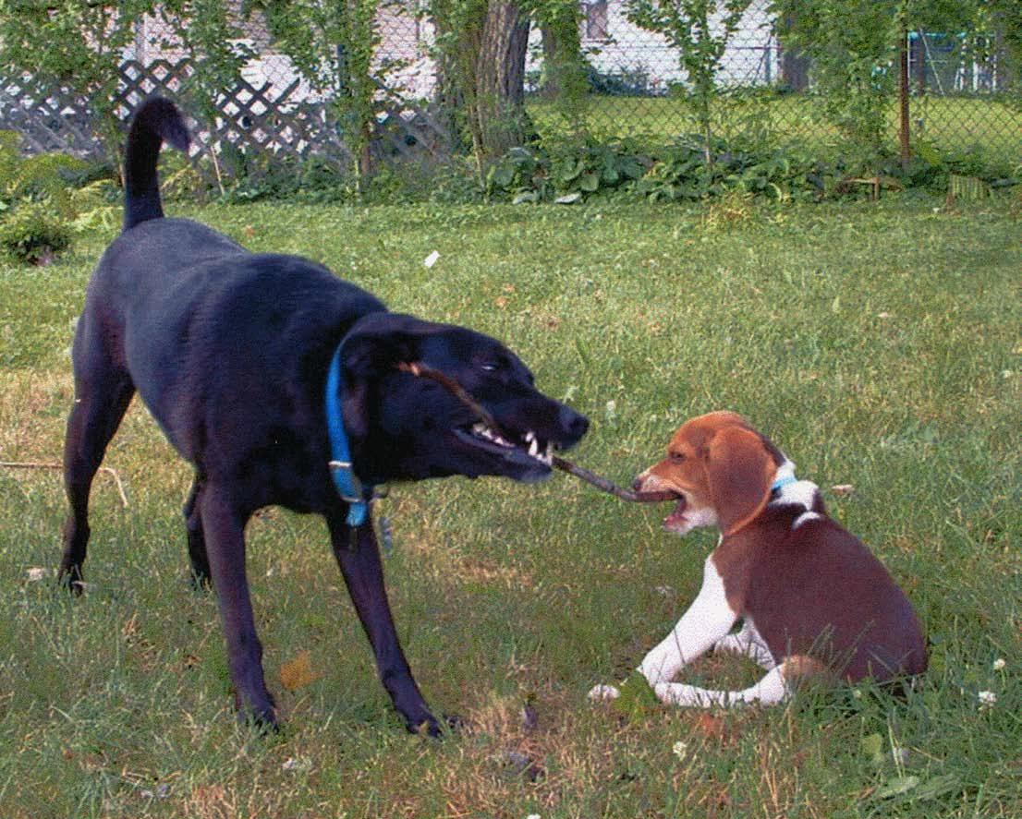
Notes:
Okay, gratuitous picture of my puppies! Just to give your brains and eyes a quick break, and to introduce the next section.

Slide 75
Are you Ready? RDA Basics for Copy Catalogers pt. 2: Preparing a Technical Services Department
Sevim McCutcheon, Catalog Librarian; Assistant Professor
Kent State University, Kent, Ohio, USA
Lmccutch@kent.edu
330-672-1703
Notes:
At Kent State University, we have been actively preparing ourselves and our staff for RDA since 2009. We currently accept copy cataloging in RDA and as of January 2013, we have started doing original cataloging in RDA as well.
Even though we only recently started doing original cataloging in RDA, we have been preparing for a long time and in many ways. This preparation has made the transition rather smooth for us. I am happy to share our techniques, in hopes that our experience helps other people transition to RDA.

Slide 76
Three questions
How can you prepare your library catalog for RDA?
How can you become informed and knowledgeable about RDA?
How can you help others get ready for RDA?
Notes:
In this section, I will try to answer three questions, using KSU as a case study.
How can you prepare your library catalog for RDA?
How can you become informed and knowledgeable about RDA?
How can you help others get ready for RDA? By this I mean more than your fellow catalogers. I mean everyone who works in the library. Only when administrators believe that the change to RDA is important will they provide resources for training and implementation. Only when reference librarians and circulation staff understand the basics of RDA records will they be able to assist the public well.

Slide 77
Technological side
Contact your vendor, make sure the system will load, index and manipulate new fields and subfields properly
Decide which and how much of the new fields to display to the public
Notes:
Let’s start with the easy question first, the question involving technology (Any question involving people is harder to answer!) How do you prepare your library catalog for RDA?
The first step is to make sure that your catalog will accept the new RDA fields, such as the 264 and the 336, 337, and 338 fields. Contact your system vendor. Kent State University’s catalog, called KentLINK, uses Innovative software. It was rather easy for our systems librarian to turn on the new fields in the load table. We’ve had a little problem with the dates in 264s not sorting properly, from latest to earliest or vice-versa. So our systems librarians along with many others from other institutions have contacted Innovative and urged them to fix the problem.

Slide 78
RDA in Public View
Display and Labeling issues
264 field
336, 337, 338 fields
Sadly, vendors haven’t created cute little icons for 336-338 yet
Notes:
There are several fields new to RDA that require libraries to make display and/or labeling decisions:
These include the 264 and 33x.
Which of these new fields, and what portions of these fields, should display to the public?
And when the public user of the catalog encounters these fields, what should the fields be called?
Ideally, vendors would make icons for the various combinations of 336, 337, and 338 fields, but they haven’t yet responded to librarians’ requests. This makes some of us sad and mad. But in the meantime we have to do the best we can for our public with what we have to work with.

Slide 79
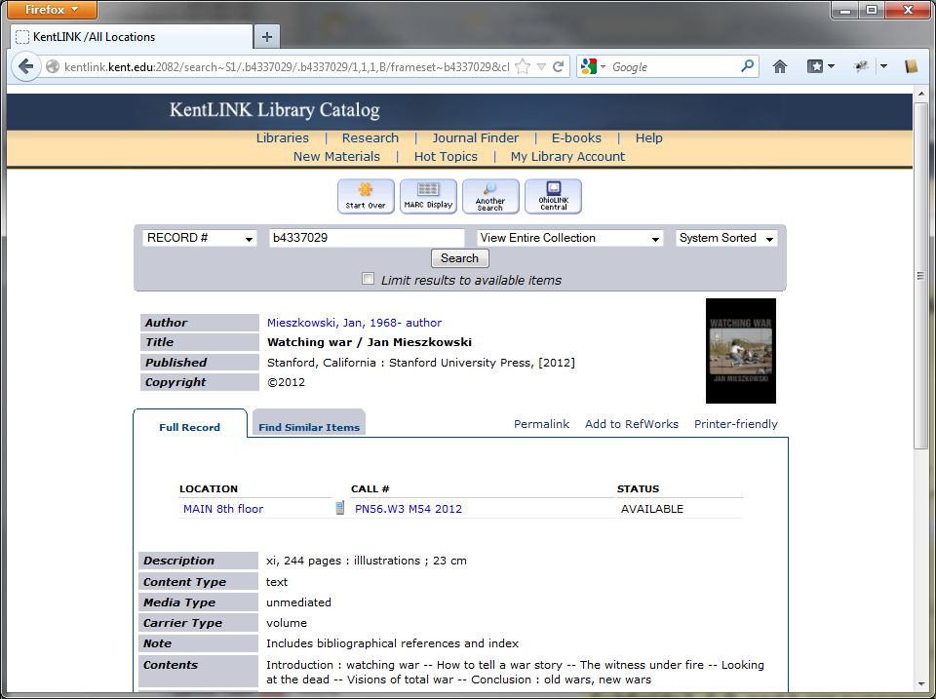
Notes:
Here’s one possible way to set up your public catalog to show RDA 264 and 33x fields.
I think the top part with the 264 is okay, but the 33x fields; content type, media type, and carrier type, could use some improvement. They are not as user-friendly as they could be.

Slide 80
Notes:
At KSU Libraries, the members of the Cataloging Committee consulted with public services personnel as much as possible about what to show to the public. After seeing common combinations of terms used in the 33x fields, it was an easy decision to suppress the 337 from public view. The terms in the 337 are pretty general and duplicate the root words of the 338.
We also suppressed subfields within each 33x field that just have no meaning for end users, like $2 rdacontent.
If you’d like more specific information on what we chose to display and suppress, by all means, get in touch.

Slide 81
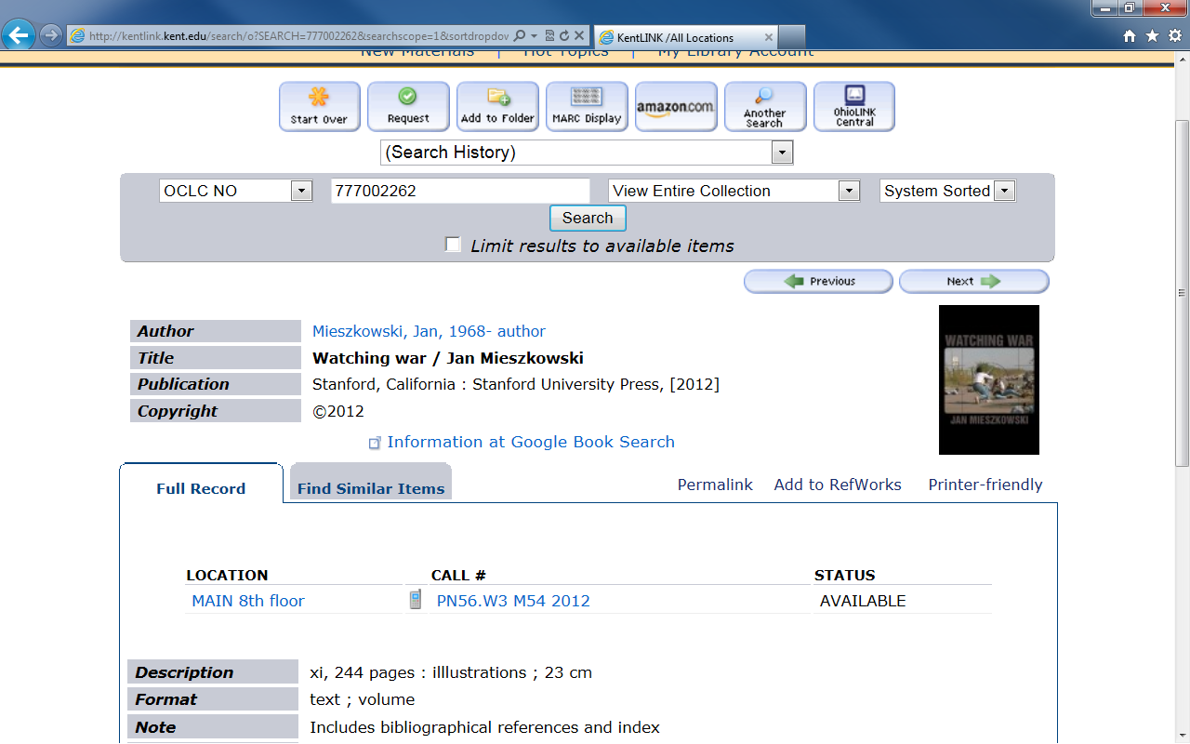
Notes:
Book record
You may recognize this one from the exercises.
You see publication and copyright information on separate lines.
For the content, 336, and carrier, 338, at first we catalogers proposed to public services folks that we use the default labels and terms for the public, which would give us two lines with “content: text” then “carrier:” volume”. They said that when they heard “carrier” they thought of air lines and cell phone companies, and it just wouldn’t do. I like their suggestion better: to have one line called “format” and to list the 336 and 338 terms one after another in it.

Slide 82
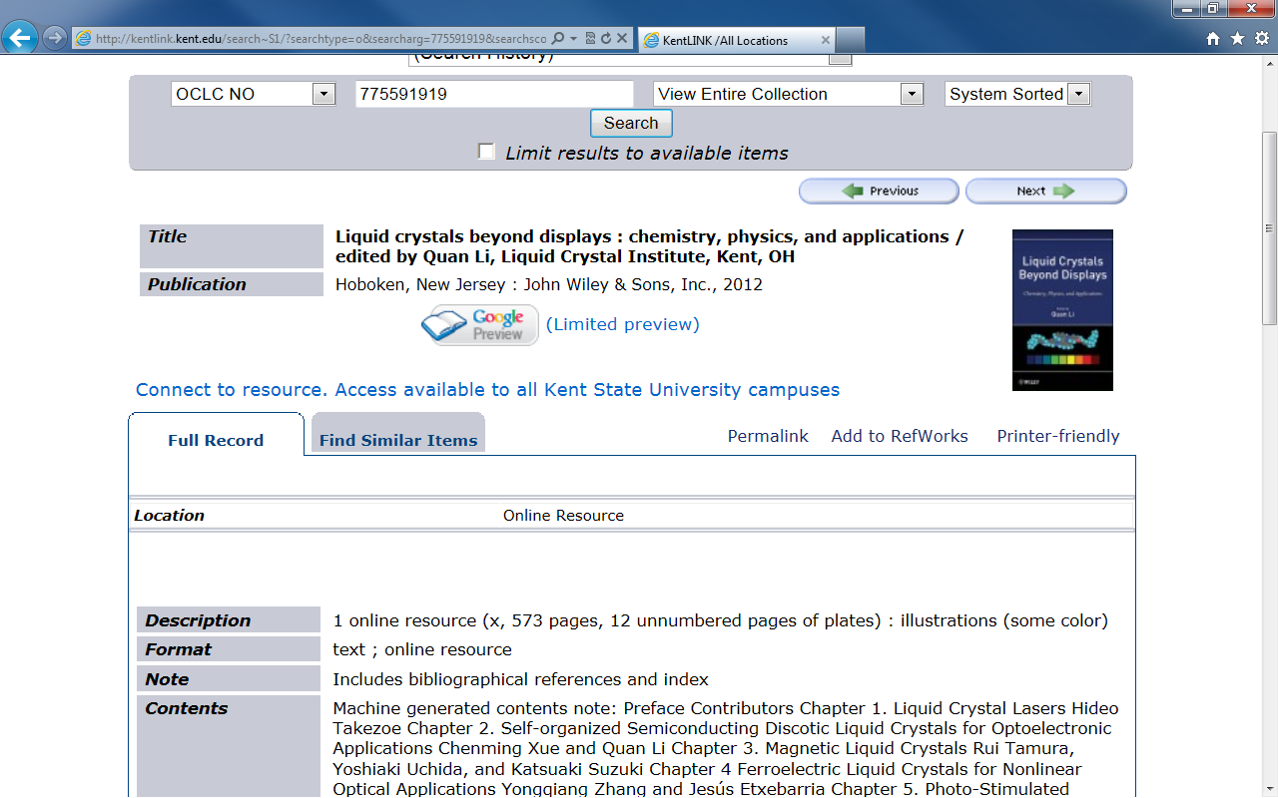
Notes:
And here’s the electronic book record we looked at.

Slide 83
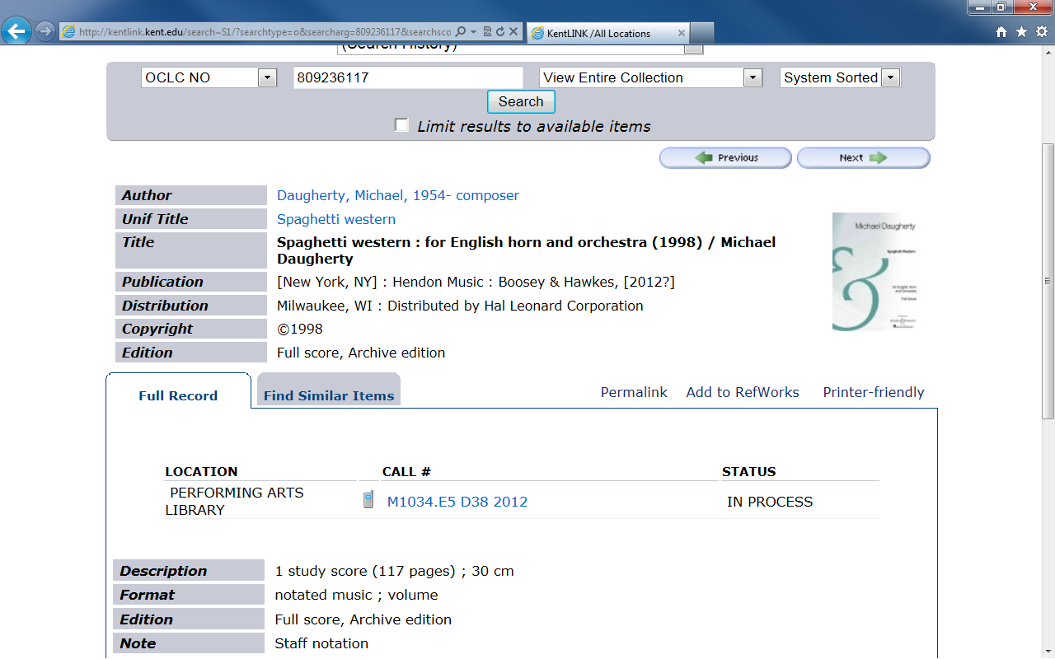
Notes:
And a score, with an interesting set of publication, distribution, and copyright data.

Slide 84
People side
How can you become informed and knowledgeable about RDA?
How can you help others get ready for RDA?
Notes:
Let’s turn our attention now to the people side of the transition.
The big question is: how do you prepare yourself and others for RDA?
And who all needs to be prepared?
To give you a little background, at KSU’s main library, we have a Head of Metadata and Catalog. We have 5 catalog librarians who specialize in different formats. We are assisted by several experienced paraprofessionals in Acquisitions and Cataloging. In addition, we have student workers, who are like apprentice catalog librarians. They are currently attending Library School to get a master’s degree, and they are specializing in cataloging. These groups were our main focus for training. However, we’ve also reached out to Reference, Circulation and Interlibrary Loan staff, plus people at branch libraries on campus and at the 8 regional libraries who need to learn at least a little bit of what to expect. So there are a lot of people in our institution who need to make the transition from AACR2 to RDA.

Slide 85
Getting started – you need a leader
At least one person with energy and vision takes the initiative
Get administration on board, informed
Educate self /head of cataloging
Discussion lists like RDA-L, AUTOCAT
Professional literature
Conferences, workshops
Select a future trainer and train that trainer
Get a subscription to RDA Toolkit
Notes:
Somebody’s got to get things moving. It requires someone with initiative and vision to get an institution moving forward, a leader. This leader often hears about big changes and trends before the average person.
In order to get support for a training initiative, it’s valuable to get the administration on board – to explain that the first major change in 40 years is happening now to cataloging standards, and that there will be the need for time and money to prepare. If you’re not a manager yourself, then there’s a need to get the head of cataloging informed and familiarized. There will be a need to pick out an in-house trainer, which may or may not be you, and for resources to train the trainer. Some ways to get up to speed are to subscribe to discussion lists, attend conferences and workshops, and read professional literature. Another big way is simply to play around in RDA Toolkit. If at all possible, an institution should get a subscription to it. There are some special deals going on right now, such as getting one month free trial for institutions; and workshop participants get a month’s free access after workshops take place.
[It’s easier to do if you have co-workers or colleagues. If you are alone at your institution, band together with other catalogers at other institutions.]

Slide 86
Manage the psychological side of the big change
Build confidence. Assure coworkers they can handle it
“Old timers” can remind that us that we’ve been through rule changes before, and so we can do it again
Assure coworkers that there will be training and support over a long period of time
Notes:
But making the transition is more than just telling catalogers what buttons to press and what steps to do differently. It’s important also to stay aware of the psychological effect of a big change. Switching from one set of cataloging rules to another can be frightening. People want to do a good job, and not make mistakes. But it’s natural to make mistakes from ignorance when you are learning something new. So assure people that there will be support and training, which will enable them to do a good job. Reassure them that we are all together in this, that they are not alone.
It’s a good time to remind people of a major change they’ve been through and survived or thrived, whether it was the last cataloging rule change or something else. If anyone one on staff has been there long enough to have lived through the switch from AACR1 to AACR2, you might get them to talk about that transition, and compare it to this one.

Slide 87
Emphasize what’s similar/same:
We’ve got a mix of records created under both AACR1 and AACR2 rules in the database, and it’s okay –we’ll just have another flavor as well
Basic RDA record not that different from AACR2: familiar elements with fewer abbreviations, more transcription and relationships, and those 33x fields
Notes:
In terms of setting people at ease, and getting them in a frame of mind to learn new things, it helps to point out what’s staying the same. It’s not new to have records created under multiple cataloging codes in a database. Now with RDA we’ll just have another kind as well. Also, people comparing AACR2 records and RDA records can see a lot of similarities between the two. This is something we found out at KSU by testing RDA. People might fear that their whole professional world is getting turned upside down, and that’s not the case – it’s just getting tilted.

Slide 88
Small doses in meetings
Introduce one feature per regularly scheduled meeting
Example: terminology changes
AACR2 RDA
Main entry Preferred access point
Added entry Access point
Area Element
Then refer to that new feature/element for reinforcement
Notes:
So we’ve gone through some general ways to put people at ease and ready to accept change. Now let’s get into some of the specific ways KSU has used to prepare staff and faculty for RDA. First, when we had regularly scheduled meetings for something else, we’d take a few minutes to talk about one aspect of RDA. We also gave out handouts with the information, to reinforce what was said. We also put these handouts on our Intranet, so people could refer to them again.

Slide 89
The best way to learn something is to teach it. (google images)
Notes:
I believe firmly that a very good way to learn something is to teach it. The preparations that are necessary to give a good lesson to others force the teacher to learn the subject well. So one technique is this: invite your coworkers and staff people to a post-OLC Chapter Conference information-sharing session about RDA. Decide on a date for this session. You now have a deadline by which you must learn something about RDA, in order to teach it to others. If possible, make it mandatory, not optional, for staff to attend the session.

Slide 90
In-house workshops
Series of workshops on cataloging with RDA in various formats, given by people on staff.
Post handouts from the workshops on the Intranet
You have access to these at the KSU RDA Documentation page:
http://extra.lms.kent.edu/page/15168
Notes:
From November 2010 to the summer 2011, we at KSU did just that: catalog librarians created in-house workshops on RDA. Ironically, rules in RDA are format-free – that is, they are not divided up by format like in AACR2 – but for our workshops, we still addressed one format at a time: books, serials, sound recordings, video recordings, and maps. Each was taught by a catalog librarian who works on that format. Not only did the audience learn something, but the presenters had to learn the topic in order to teach it.
We then posted PowerPoint presentations from the workshops on the RDA page of the Intranet. There is an extranet link to this as well, so you have access to it. Because RDA has changed a little, and also because we presenters have learned more in the past few years, the workshops from 2010-2011 are a little out of date. However, I share them here to give you a model of what a Metadata and Catalog department can do to prepare.

Slide 91
Documentation/ Standards
Had document, “Copy Cataloging New Monographs: Fields to Check” for AACR2
Made a “Fields to Check” document for RDA
245 Title
Accept capitalization if it matches what appears on the title page.
Route to a catalog librarian if:
1 title or subtitle doesn’t match what’s on the title page exactly
2. any word is misspelled
3. the subtitle is missing
4. some or all of the statement of responsibility is missing
5. the statement of responsibility contains the phrase “[and X others]”
6. names listed in the statement of responsibility aren't traced in 7xx fields
Notes:
At KSU, we value documentation. We realize that many of our paraprofessionals in Acquisitions and Cataloging will not refer to the RDA Toolkit – it’s too much. For their benefit, we created much shorter documentation listing only the essential criteria. We made clear when to accept a record as-is, and when the paraprofessional should give the resource to a catalog librarian for editing. These standards are also available to you, on the KSU RDA website mentioned in the last slide.
When establishing and documenting KSU policies for RDA, we decided that our guiding principle would be that the RDA records should have at least as much information as AACR2 records. A second principle is that we will follow the LC-PCC-Policy Statements as much as possible. Now, the Policy Statements say “generally, do not omit” names from a statement of responsibility. However, many of the Policy Statements weren’t finalized when we first received RDA records, so we followed the two principles I just mentioned when deciding what to do in certain situations, such as when there are many authors.

Slide 92
Webinars, etc.
Library of Congress Catalogers Learning Workshop. RDA Training Materials
http://www.loc.gov/catworkshop/RDA%20training%20materials/index.html
ALCTS (Association for Library Collections & Technical Services)
http://www.ala.org/ala/mgrps/divs/alcts/index.cfm
JSC (Joint Steering Committee)
http://www.rda-jsc.org/rdapresentations.html
Notes:
From about 2010 to the present, we catalog librarians have watched many webinars on RDA and related topics. Some were free and some had a fee. We have benefited greatly from the training materials on LC’s Catalogers Learning Workshop, which are free. I recommend this page highly.
I notice that the JSC presentations page hasn’t been updated since 2011, but you can still find good material on the basics there. I especially recommend the 2011 presentation by Barbara Tillett and Judith Kuhagen.

Slide 93
Late Dec. 2010-early 2013
Copy catalogers and Acquisitions staff: gained comfort with copy cataloging
Catalog librarians gained knowledge
Began creating and documenting original cataloging standards
Trained others, internally and externally
Received NACO training, for name authority records
Began by doing a few originals, then requested review and correction
Notes:
After the U.S. national tests in 2010, we steadily prepared ourselves and the people around us using the techniques I mentioned on previous slides.
Our copy catalogers and Acquisitions staff are now quite familiar with RDA records they come across. They see AACR2 and RDA records regularly in the course of their work. When a record of either kind meets quality standards, they proceed and process it. When a record doesn’t meet quality standards, they send it to a catalog librarian for upgrading.
We catalog librarians meet regularly to discuss and decide upon standards for original cataloging. We’re not finished deciding and documenting our local policies for original cataloging in all formats, but we are making progress. It’s easier to discuss original cataloging policies knowledgably now that we’ve done some originals. You see, in January, once we got NACO training in how to create Name Authority Records in RDA, it seemed a natural time to start doing bibliographic records.
Our process was to start slowly and ask for feedback along the way. For example, Peter the Music and Media catalog librarian created his first score and DVD bibliographic records in RDA. Then he sent them to a more experienced RDA cataloger at a different university for review and corrections. Then Peter shared the feedback he got via email with us other catalog librarians, so we could learn from his experiences. I created a template for ETDs (electronic theses and dissertations) records. I asked on the RDA-L and AUTOCAT discussion lists for someone to review my work. About 4 people did, including Robert Maxwell, the author of books on FRBR and RDA. After they were reviewed, I changed and fixed many things. I share these stories with you because I want to encourage you to share your work with others and ask for feedback. We learn from our mistakes.

Slide 94
Papers that influence KSU’s local decisions
Incorporating RDA practices into WorldCat: A discussion paper (2012)
http://www.oclc.org/us/en/rda/discussion.htm
OCLC RDA Policy Statement effective March 31, 2013
http://www.oclc.org/us/en/rda/new-policy.htm
Notes:
Because we are members of OCLC, OCLC policy statements and discussion papers influence our local decisions. We want to follow international standards as much as possible, and discussed the implications of OCLC’s decisions at our Cataloging Committee meetings.
I’m not suggesting that you have to adopt OCLC policies in full. However, reading these documents can give you information about how to form your own policies, by illustrating what kind of topics can or should be addressed.

Slide 95
Feb. 1, 2013: deadline for student workers
Students = complex copy and original catalogers
Email list of readings to prepare for
Original cataloging of books in RDA
Upgrading less-than-full AACR2 records to RDA
Notes:
You may remember that our student workers are in Library School. They have learned something about RDA in class. They are like apprentice catalog librarians, so under supervision they do complex copy cataloging, where they improve existing bibliographic records; plus original cataloging. I prepared my student workers by sending an email with a list of assigned readings. I gave them a deadline of February 1st 2013 to prepare. Starting on that date, my monograph student workers started editing and improving minimal level records in RDA, and original cataloging in RDA. Once they edit a record, I review it before it is added to the OCLC WorldCat database. When there are questions or ambiguity, we look up the rules in RDA Toolkit together, and we both learn something new.

Slide 96
Assigned readings for apprentice catalog librarians
“Designing Policy for Copy Cataloging in RDA,” Sevim McCutcheon. Library Collections, Acquisitions, and Technical Services 36(3-4) (2012), p. 69-78.
“What is FRBR?” Barbara Tillett. http://www.loc.gov/catdir/cpso/whatfrbr.html
RDA Toolkit, chapters 1 and 2 (Manifestations); including LC-PCC-PSs
Notes:
Provided here is the list of resources I wanted my student workers to read before originally cataloging in RDA.

Slide 97
Assigned readings and resources, continued
“Changes from AACR2 to RDA: A comparison of examples. Part 1: Description”/ by Adam Schiff. Look for July 2012, the most recent version http://faculty.washington.edu/aschiff/
MARC 21 Format for Bibliographic Data http://www.loc.gov/marc/bibliographic/
Using the RDA Toolkit, from LC’s CLW http://www.loc.gov/catworkshop/RDA%20training%20materials/index.html
Notes:
And here are the rest of them.

Slide 98
Next steps
Work at the consortium level, OhioLINK
On Task Force to recommend technological changes to Innovative
On committee to recommend display and labeling to OhioLINK consortium members
Establish RDA standards for ETDs
Work to train public , school librarians
Volunteered to train in all 4 corners of Ohio this spring
Writing article about RDA in Ohio public libraries
Notes:
Now that we have the transition to RDA at KSU under control, we catalog librarians and our Head of Metadata and Catalog are working to share information and improve the situation in the wider world, starting with our consortium. All Ohio universities and the State Library of Ohio are members of the OhioLINK Consortium. OhioLINK provides a shared catalog and a repository of ETDs (electronic theses and dissertations). Kent State University Libraries is well-represented on OhioLINK committees that are making decisions and recommending improvements regarding RDA.
I think this is the same in many areas: academic libraries are on the cutting edge, learning about and implementing something new first. Only later do the public and school libraries adopt the new development. My next personal mission is to train Ohio public librarians. I did a survey of Ohio public library catalogers in the late fall 2012 and learned that 1/3 of them had never heard of RDA. There is a lot of training and knowledge-sharing to be done in many arenas.

Slide 99
OLC NE : You have access to RDA Toolkit for 30 days, until April 27, 2013:
See handout for instructions
Notes:
One of the best ways to learn RDA is to delve into it. You can read RDA for yourself for the next month.
As participants in this workshop, you have free 30 day access to the RDA Toolkit.

Slide 100
OLC NW : You have access to RDA Toolkit for 30 days, until May 12, 2013:
See handout for instructions
Notes:
One of the best ways to learn RDA is to delve into it. You can read RDA for yourself for the next month.
As participants in this workshop, you have free 30 day access to the RDA Toolkit.

Slide 101
Just play in the Toolkit! (google images)
Notes:
So, just play!

