Slide 1
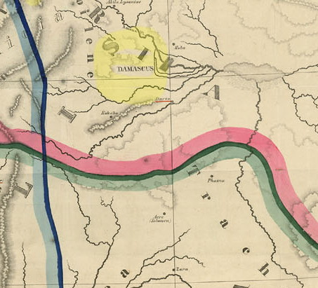
RDA For Sheet Maps in MARC Coding
Weiping Zhang
Government Documents Librarian
With the help of Stacey Ahle
June 29, 2011

Slide 2
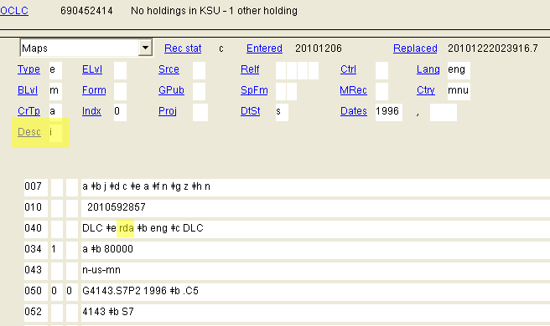
How Can I Tell a RDA Map Record?
Desc “I” or blank (fixed field)
040 $e rda

Slide 3
1xx Fields
Record relationship term(s)
100 1 Santosa, Silvio, $e cartographer.
2 Magic Map (Firm), $e cartographer, $e publisher.
(rda description of relationship designators says “one” or “more”.)

Slide 4
245 Title Statement
No rule of three, record all names if available
No [GMD]
245 1 0 Bali pathfinder / $c all maps are hand-drawings by Silvio Santosa ; water color illustration by Nyoman Miasa.

Slide 5
250 Edition Statement 255 Cartographic Mathematical Data
Fewer abbreviations
10th edition.
250 10th ed..
255 Scale approximately 1:200,000.

Slide 6
260 Publication Place, Publisher, Dates
No more [s.l.] and [s.n.]
[Place of publication not identified] : $b [publisher not identified]
260 Vancouver, B.C. : $b International Travel Maps, $c [2010], ©2010.

Slide 7
300 Physical Description
No abbreviations except for measurement of the Item
2 maps on 1 sheet : $b both sides, color ;
$c 92 x 57 cm each
Abbreviation okay for measurement

Slide 8
336-338 Content , Media, and Carrier
Three new fields to replace GMD
336 Cartographic image $2 rdacontent
Unmediated $2 rdamedia
338 Sheet $2 rdacarrier

Slide 9
5xx (Notes) and 6xx (Subject Headings)
More notes are encouraged
Title from panel.
500 Includes loop inset, text, color illustrations, and diagrams.
“Funding by AT&T.” Map shows location of AT&T stores.
655 Genre/Form terms
RDA records include 655 fields
0 Thematic Maps
655 0 Statistical Maps
0 Nautical Charts

Slide 10
7xx Fields
Record relationship term(s)
1 Miasa, Nyoman, $e illustrator.
2 Chicago CartoGraphics (Firm), $e
cartographer.
710 2 AT&T., $e sponsoring body.

Slide 11
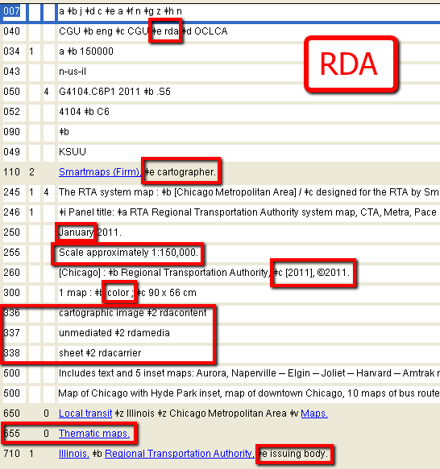
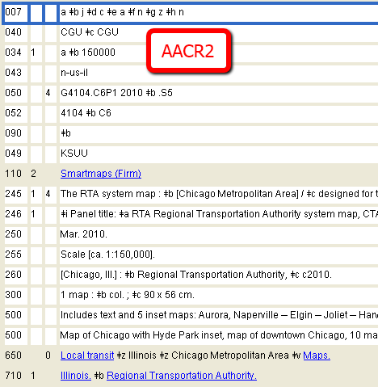
Differences…

Slide 12
RDA Resources for Map Cataloging
RDA and Cartographic Resources
Mary Lynette Larsgaard and Paige G. Andrew (Forthcoming,
January 2012). Providing the first practical cataloging guide for cartographic resources using standard of RDA.
OCLC RDA master record for maps:
#668499427
Example Records (public display mode):
http://lccn.loc.gov/2010329204
http://lccn.loc.gov/2010586707

