Slide 1
PDSC Faculty Research and Collaboration Workshop Series http://www.library.kent.edu/PDSC_FRCW_Session_1
Session 1: "I've got a great idea for a study..."
In this session, we will explore choosing research methods, developing research questions/hypotheses.

Slide 2
“I’ve got a great idea for a study” Overview
Framework for choosing research methods
  Research Paradigms
  Inductive and Deductive Research
  Qualitative, Quantitative, and Mixed Methods
Evaluating and Selecting Library & Information Science Research Methods
  Introduction to types of LIS research
Identifying Research Questions & Hypotheses
  Defining Terms
  Types of Hypotheses
  Evaluating Hypotheses & Research Questions

Slide 3
Framework for choosing research methods: Research Paradigms
Research Paradigms (adapted from Creswell, 2003)
  Post-positivist
  Constructivist / Deconstructionist
  Advocacy / Participatory
  Pragmatic

Slide 4
Postivism and Postpositivism Knowledge Claims
(Adapted from Creswell, 2003)
Thinkers
  Popper, Newton, Comte, Mill
Key Points
  Reality/Meaning can be modeled.
  Seek to replicate and test models.
  New model can replace old model if it is has more predictive/explanatory power.
  Tends to quantitative and more in line with physical science definition of science.

Slide 5
Constructivism and Interpretivism Knowledge Claims
(Adapted from Creswell, 2003)
Thinkers
  Vygotsky, Piaget, Lincoln & Guba, and Mertens
Key Points
  Reality/Meaning is constructed
    Socially – Vygotsky
    Individually -- Piaget
  Reality/Meaning is contextual
  Reality/Meaning is subjective

Slide 6
Advocacy/Participatory Knowledge Claim
(Adapted from Creswell, 2003)
Thinkers
  Marx, Habermas, Freire, Kemmis & Wilkinson
Key Points
  Reality/meaning is socially constructed
  Research is intertwined with politics and political agendas
  Addressess issues of empowerment, voice to the marganilized, oppression...
  Tends to be qualitative
Types
  Feminist perspective
  Queer theory
  Disability inquiry
  Racialized discourse
  Critical Theory

Slide 7
Pragmatist Knowledge Claim (Adapted from Creswell, 2003)
Thinkers – Pierce, James, Mead, and Dewey
Key Points
  Researches are not tied to a particular philosophical world view (knowledge claim)
  Researchers are free to choose the methodology (qualitative, quantitative, mixed methods) that appears to address the problem at hand.
  Practical problem solving oriented
  Tends to utilize a mixed-methods (qualitative and quantitative) approach

Slide 8
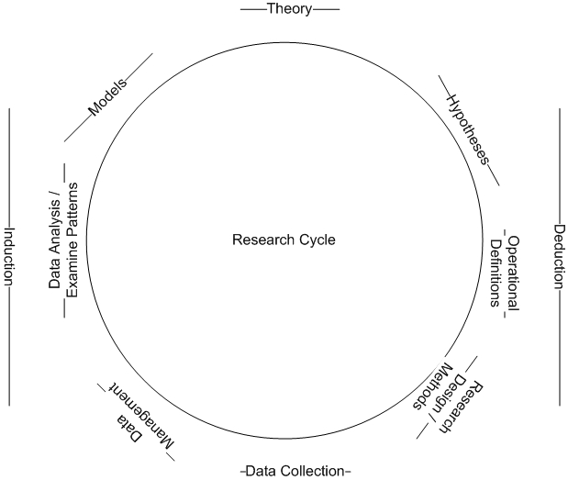
Inductive vs. Deductive Research

Slide 9
Qualitative
Most often used by constructivists, advocacy/participatory researchers.
Traditions
  Ethnographies – longitudinal study of intact culture in natural setting.
  Grounded Theory – Abstract from views of participants.
  Case Studies – Indepth study of a individuals, an event, or a process.
  Phenomenological Research – “researchers identifies ‘essence’ of human experiences concerning a phenomenon, as described by the participants in a study”
  Narrative Research – Collects stories of individuals.

Slide 10
Quantitative
Key Concepts
  Experimental designs
  Non-experimental Designs – e.g. surveys
  Scientific Method
  Empiricism
  Claims Objectivity
  Most often used by post positivists.

Slide 11
Mixed Methods
Types
  Sequential – Qualitative to quantitative or quantitative to qualitative.
  Concurrent – Integrate qualitative and quantitative methods and data.
  Transformative – Theory driven choices in data collection techniques.

Slide 12
Paradigms and Methodologies

Slide 13
Evaluation and Selecting
Library & Information Science Research Methods
List adapted from Powell and Connaway (2004) Basic Research Methods for Librarians (4th ed.)
  Historical research
  Bibliography
  Operations research
  Modeling
  Case study
  Delphi study
  Content analysis
  Comparative librarianship
  Tech-based research
  Systems analysis
  Survey research
  Experimental research
  For Definitions and Examples see:http://www.library.kent.edu/PDSC_FRCW_Additional_Resources

Slide 14

Identifying Research Questions & Hypotheses
Defining Variables and Values
Operational Definitions
Statement of Problem
Purpose Statement
Types of Hypotheses
Pseudohypotheses
Research Questions

Slide 15
Identifying Research Questions and Hypotheses: Defining Terms
Definitions
  Variable – a finding that can vary and possess one or more values.
    Independent and Dependent
  Value – the attributes of a variable.
    Categorical and Continuous
  Operational Definition – Defining a term or concept by how it will be measured.
Identify the variables and values in these research questions. Are the variables operationally defined?
  Did referrals decrease in the spring semester as compared to fall semester?
  In what category of transaction (direction, machine, or reference) did the referral fall?
  (From:http://journals.ohiolink.edu/ejc/pdf.cgi/Dinkins_D.pdf?issn=00991333&issue=v36i0004&article=279_mrtuopatrd)

Slide 16
Identifying Research Questions and Hypotheses: Defining Terms
Characteristics of a Good Quantitative Statement of a Research Problem – adapted from Gay, 1992
  Specifies variables of interest
  Specifies relationship between variables.
  Specifies types of subjects in study.
  Operationally defines variables of interest.
  Should be stated as early as possible in article.
  Should include background and justification.

Slide 17
Identifying Research Questions and Hypotheses: Defining Terms
Types of Hypotheses
  Directional and Nondirectional
  Statistical and Null
Pseudohypotheses
  No basis for comparison
  Value Judgements

Slide 18
Identifying Research Questions and Hypotheses: Defining Terms
Research Questions
  Posed broadly such as to indicate methodology but not limit scope or depth of study.
    Use “what” or “how”
    Use exploratory verbs
    Use nondirectional language
  Creswell (2003) recommends researchers ask two primary questions and several secondary questions.
    These questions should directly correspond with a methodology
    These questions will change as the study unfolds
    Depending on methodology, questions may not be directly relatable to lit review.

Slide 19
Identifying Research Questions and Hypotheses: Defining Terms
Examples of Theoretical Questions in the Qualitative Tradition – Marshall and Rossman (1995)
  “How does one’s play affect reading readiness? Through what cognitive and affective processes? Do children who take certain roles – for example, play leadership roles – learn faster? If so, what makes the difference?”
  How does protégé socialization process function in the school administration careers? Does it work differently for women? For minorities? What processes are operating?
Examples of Particular Population Questions in the Qualitative Tradition -- Marshall and Rossman (1995)
  “How do neurosurgeons learn to cope with the reality that they hold the lives of people in their hands and many of their patients die?
  “What happens to women who enter elite M.B.A. programs? What are their career paths?”
  “What is the life of the long-distance truck driver like?”

Slide 20
Activities & Discussion
Bags o’ junk introduction to the research process
  Using everyday objects to model and discuss the inductive and deductive process
Gallery Walk
  Small group work generating research ideas
  For Additional Resources:
http://www.library.kent.edu/PDSC_FRCW_Additional_Resources

