Slide 1
Introduction to SAS Programming
Christina L. Ughrin
Statistical Software Consulting
Some notes pulled from SAS Programming I: Essentials Training

Slide 2
SAS Datasets
Examining the structure of SAS Datasets

Slide 3
SAS Data Sets
Two Sections
  Descriptor Section
  Data Section

Slide 4
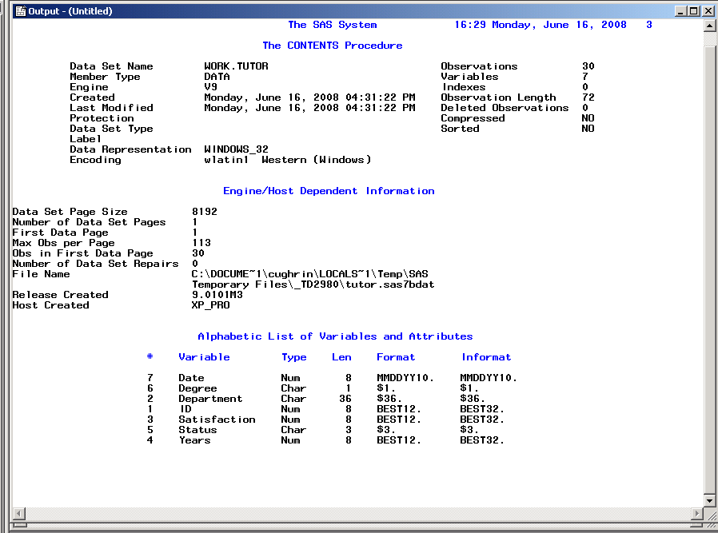
Data Set Descriptor Section

Slide 5
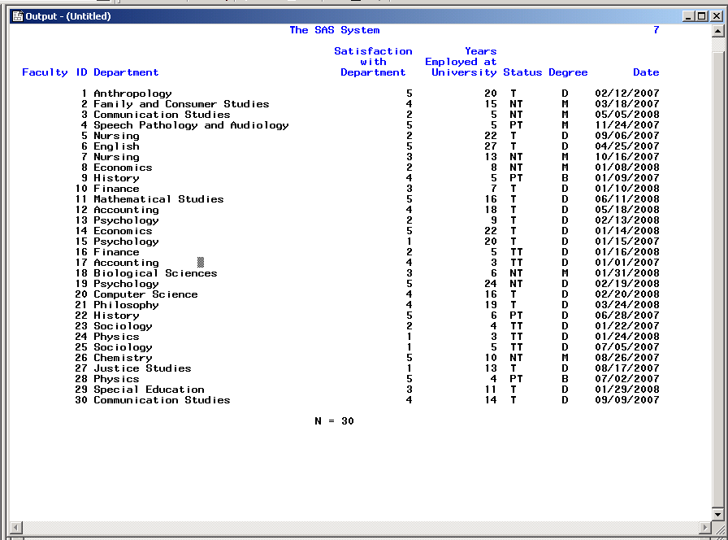
SAS Data Section

Slide 6
Attributes of Variables
Name
  e.g. Status
Type
  Numeric or Character
  e.g. Status in this example is character (T, TT, PT, or NTT) and Satisfaction is numeric (1 to 5).

Slide 7
SAS Data Set Terminology
Variables – columns in a SAS data set.
Observations – rows in a SAS data set.
Numeric Data – values that are treated as numeric and may include 8 bytes of floating storage for 16 to 17 significant digits.
Character Data – non numeric data values such as letters, numbers, special characters, and blanks. May be stores with a length of 1 to 32, 767 bytes. One byte is equal to one character.

Slide 8
SAS Data Set and Variable Name Criteria
Can be 32 characters long.
Can be uppercase, lowercase, or a mixture of the cases.
Are not case sensitive
Cannot start with number and cannot contain special characters or blanks.
Must start with a letter or underscore.

Slide 9
SAS Dates
Dates are treated as special kind of numeric data.
  They are the number of days since January 1st, 1960. January 1st 1960 is the 0 point. SAS dates can go back to 1582 (Gregorian Calendar) and forward to the year 20000.
  Dates are displayed using a format. There are a number of different date formats supported by SAS.
Time is scored as the number of seconds since midnight. SAS date time is the number of seconds since January 1st, 1960.

Slide 10
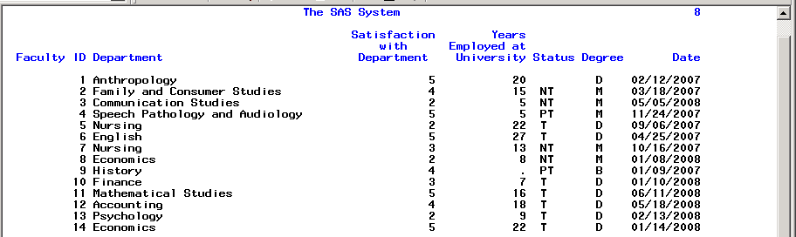
Missing Data in SAS
Missing values are valid values.
  For character data, missing values are displayed as blanks.
  For numeric data, missing values are displayed as periods.

Slide 11
SAS Syntax

Slide 12
SAS Syntax
Statements in SAS are like sentences. The punctuation though is a semicolon( ; )rather than a period ( . )
Most Statements (but not all) start with an identifying key word (e.g. proc, data, label, options, format…)
Statements are strung together into sections similar to paragraphs. These paragraphs in a Windows OS are ended with the word “run” and a semicolon.

Slide 13
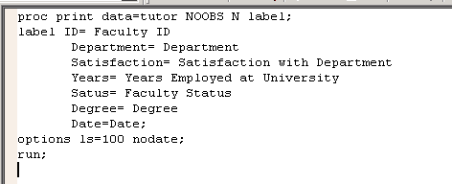
Example of SAS Syntax

Slide 14
SAS Syntax Rules
SAS statements are format free.
One or more blanks or special characters are used to separate words.
They can begin and end in any column.
A single statement can span multiple lines.
Several statements can be on the same line.

Slide 15
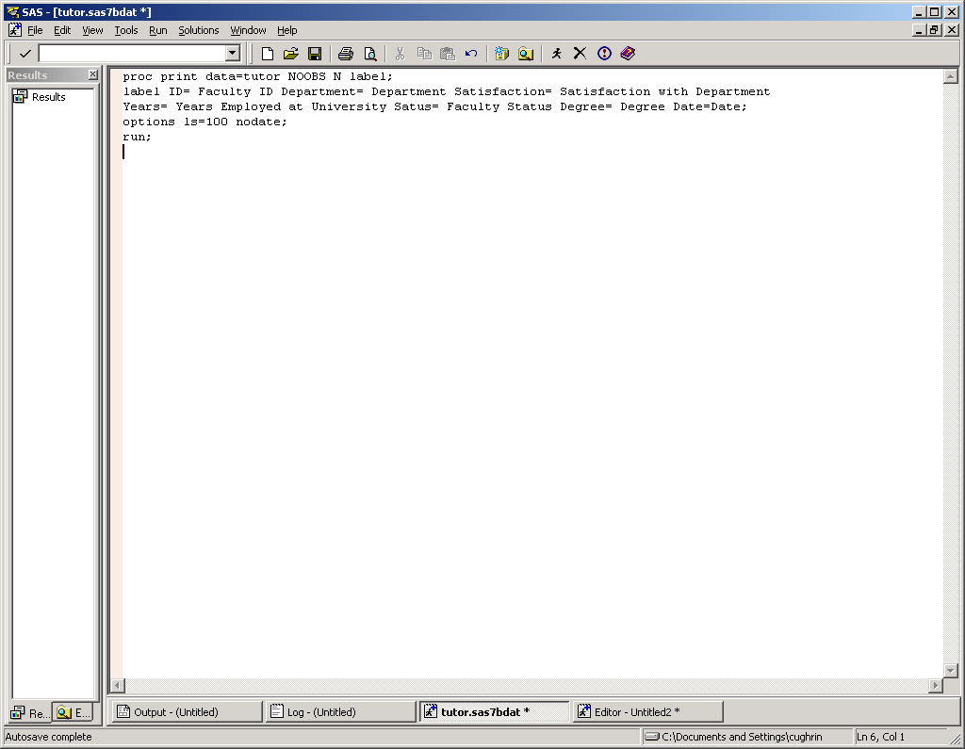
Example of SAS Free Format
Using the free-format Syntax
rules of SAS though can make it difficult for others (or you) to read your
program. This is akin to
writing a page of text with little attention to line breaks. You may still have
Capital letters and periods, but where a sentence begins and ends may be a bit confusing.

Slide 16
Example of SAS Formatted
Using the free-format Syntax rules of SAS though can make it difficult for others (or you) to read your program. This is akin to writing a page of text with little attention to line breaks. You may still have capital letters and periods, but where a sentence begins and ends may be a bit confusing. Isn’t this paragraph a bit easier to read?

Slide 17
SAS Comments
Type /* to begin a comment.
Type your comment text.
Type */ to end the comment.
Or, type an * at the beginning of a line. Everything between the * and the ; will be commented.
  e.g. *infile ‘tutor.dat’;
Alternatively, highlight the text that you would like to comment and use the keys Ctrl / to comment the line. To uncomment a line, highlight and use the Ctrl Shift / keys.

Slide 18
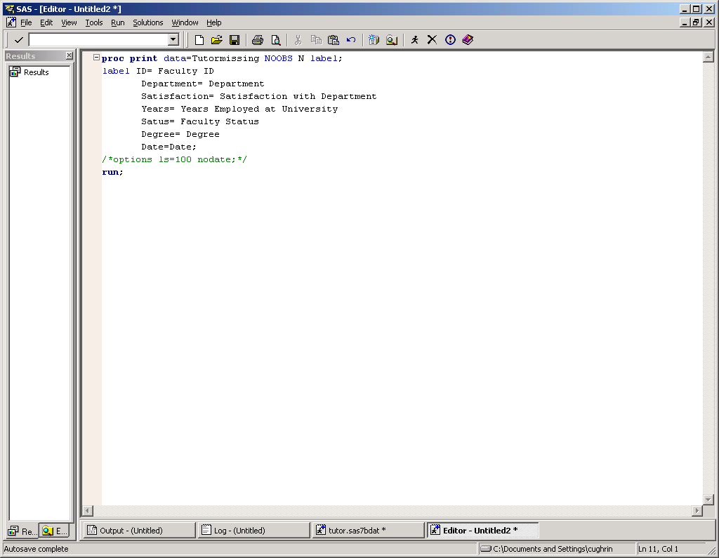
SAS Comments

Slide 19
SAS Windows

Slide 20
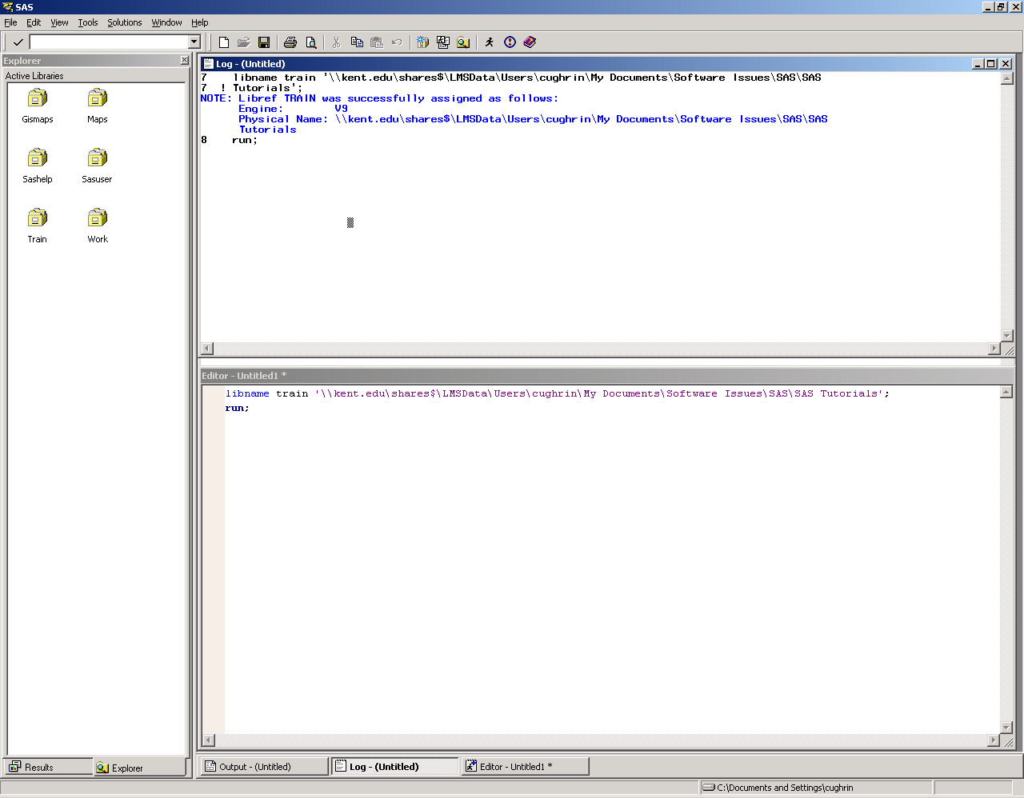
SAS Windows
Explorer
Log
Editor

Slide 21
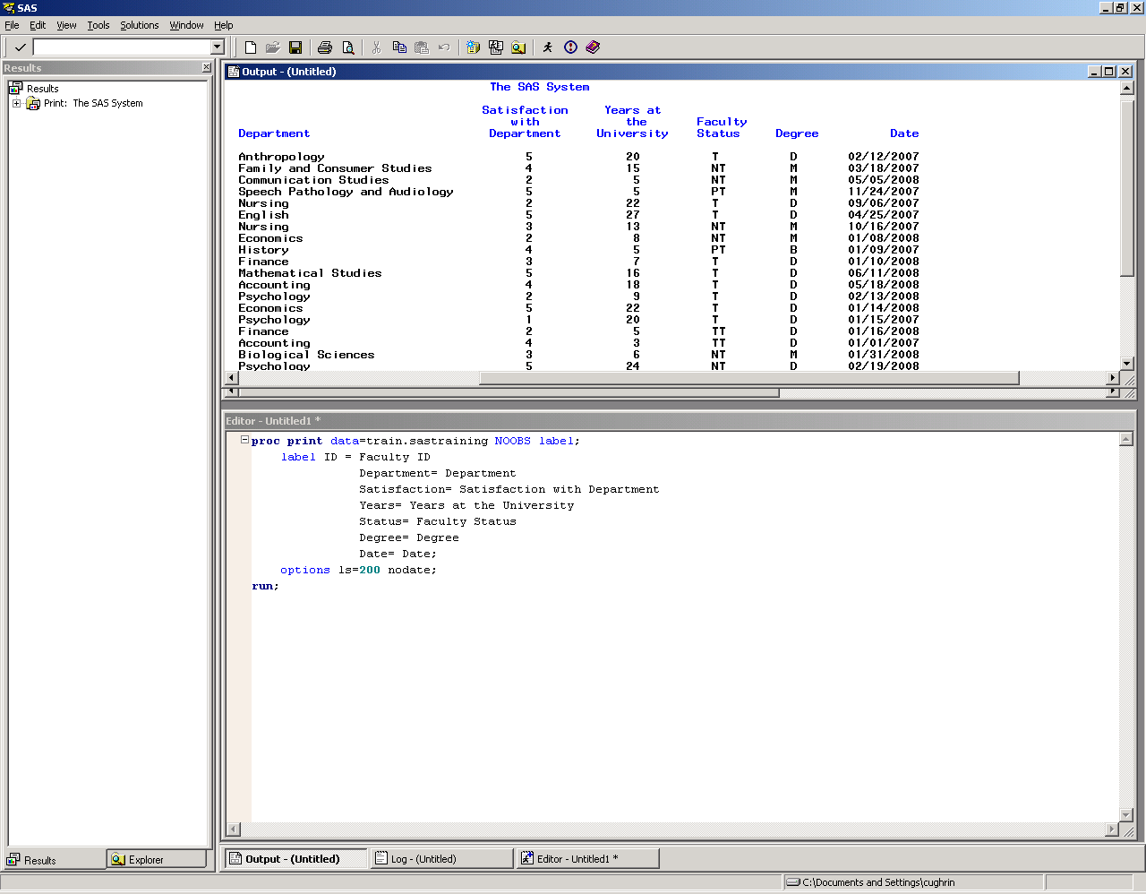
Enhanced Editor Window
Output
Enhanced Editor
Your program script appears in this window.
You can either bring it in from a file or type the program right into the window.
Once the program is in the window, you can Click Submit (or the running guy).

Slide 22
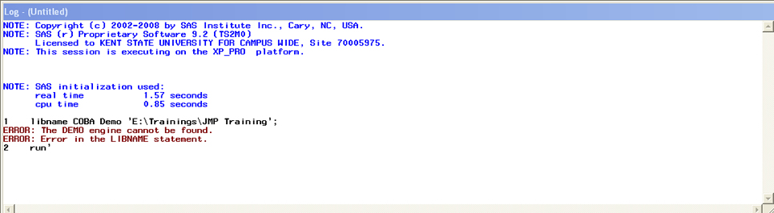
SAS Log
SAS Log provides a “blow by blow” account of the execution of your program. It includes how many observations were read and output, as well as, errors and notes.
Note the errors in red.

Slide 23
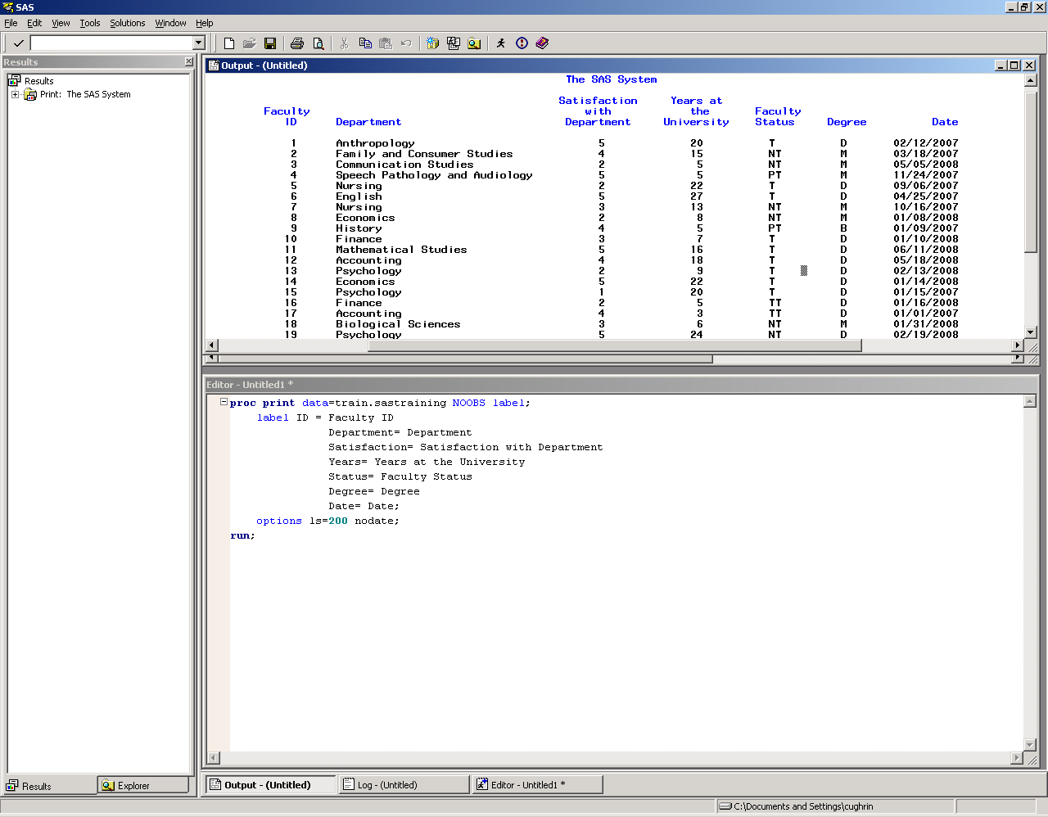
Output Window

Slide 24
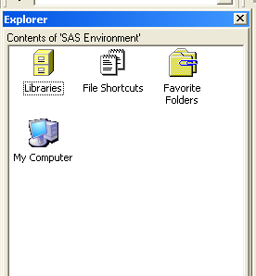
SAS Library
SAS Data Libraries are like drawers in a filing cabinet. The SAS data sets are files within those drawers. Note the icons for the SAS library match that metaphor.
In order to assign a “drawer”, you assign a library reference name (libref).
There are two drawers already in your library: work (temporary) and sasuser (permanent).
You can also create your own libraries (drawers) using the libname statement.

Slide 25
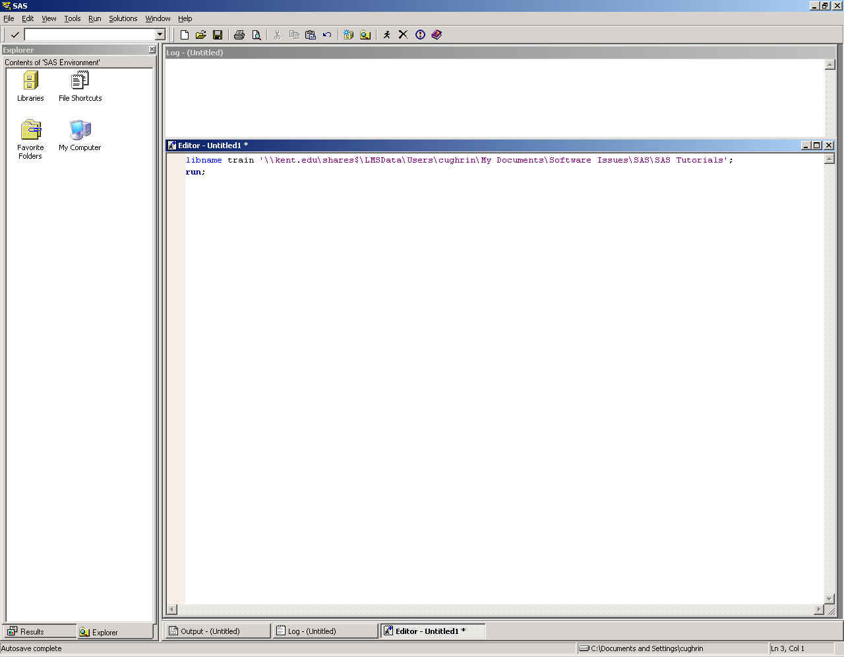
Establishing the libname
Type the libname command in the Enhanced Editor. Click on the running icon
libname Tina ‘E:\Trainings\JMP Training’;
run;

Slide 26
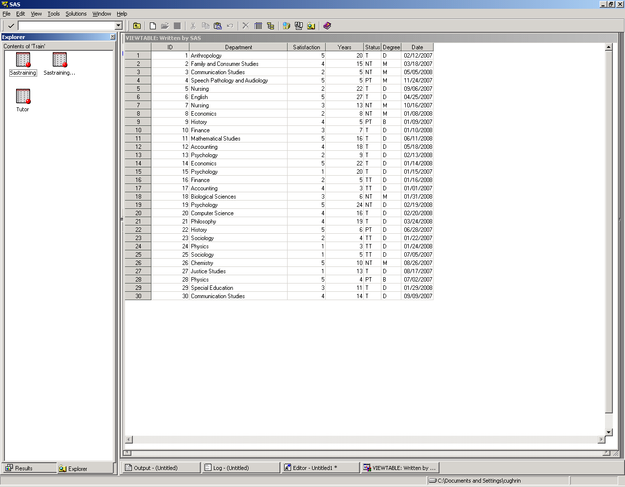
Viewtable Window

Slide 27
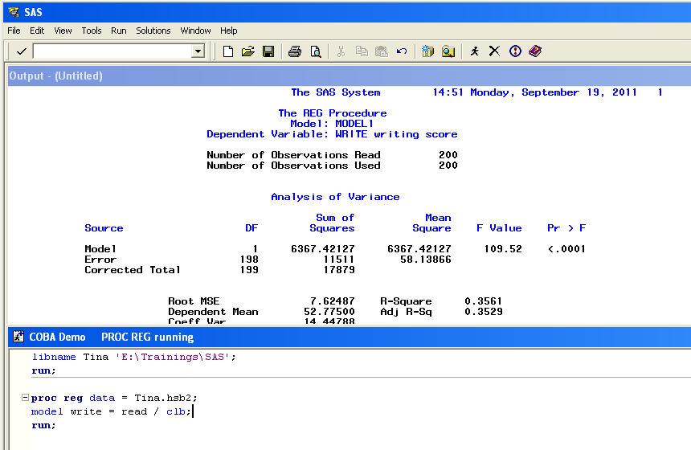
Proc Reg
Proc reg data= Tina.hsb2;
Model write = read / clb;
Run;

Slide 28
Proc Univariate
Proc Univariate

Slide 29
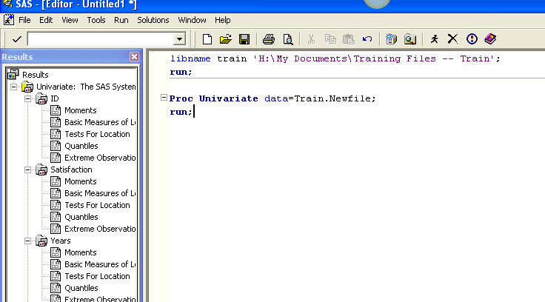
Proc Univariate

Slide 30
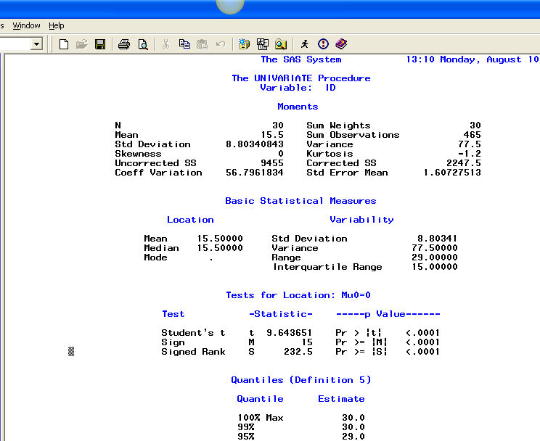
Proc Univariate

